Slide 1
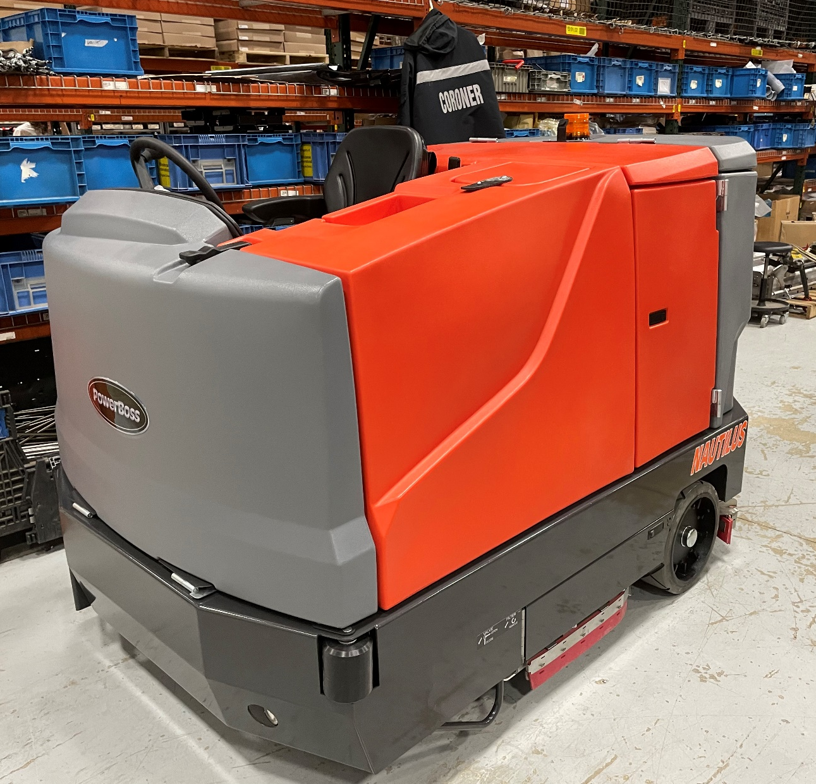
Assembly Instructions Station 2
Nautilus E Pages 1-111

Slide 2
Seat Back Plate Material List and Locations
Component | Object Description | Usage Qty | Storage Bin
L3-TG-S712 | Seat Back Plate | 1
3400384 | WASHER-CONICAL SPRING 5/16 | 2 | MIN01I07
600934 | NUT-FLANGE WIZZ M8-1.25 ZP | 2 | FAS08J02
717024 | SCR-HH M8-1.25 X 20 ZP GRADE 8.8 | 2 | FAS08E02

Slide 3
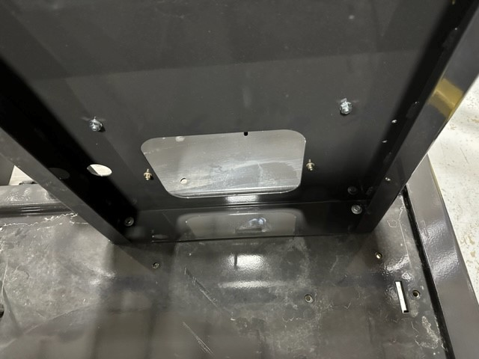
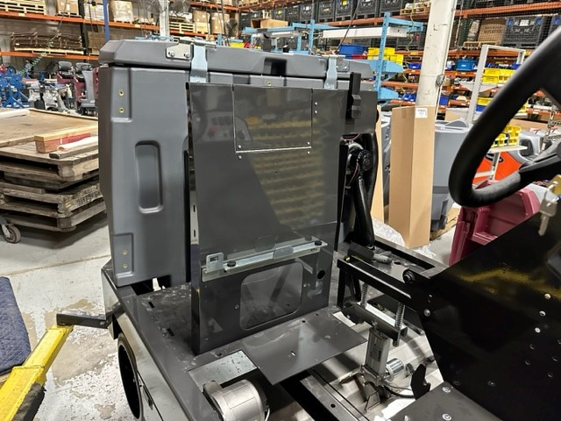
Back Panel Pg 1 of 1
Line up and install Seat Back Plate (L3-TG-S712) onto frame with 2 screws (717024), 2 conical washers (3400384), and 2 flange nuts (600934) as shown
(2)717024
(2)3400384
(2)600934
L3-TG-S712

Slide 4
Electrical Box & Wire Routing Material List and Locations
Component | Object Description | Usage Qty | Storage Bin
719119 | WELDMENT, SUPPORT BRACKET E-BOX | 1 | A1912D05
717024 | SCR-HH M8-1.25 X 20 ZP GRADE 8.8 | 1 | FAS08E02
3400384 | WASHER-CONICAL SPRING 5/16 | 3 | MIN01I07
600934 | NUT-FLANGE WIZZ M8-1.25 ZP | 3 | FAS08J02
730980 | INSERT-M6-1.00, 4.2 - 6.6 GRIP | 7 | MIN02D09
3500118 | EDGING-VINYL TRIM 1/8" X 250'
3400383 | WASHER-CONICAL SPRING 1/4 | 9 | MIN01H07
11038072 | SCR-HH M6-1.0 X 16 ZP CLASS 8.8 | 2 | FAS01D04
710180 | SCR-THMS 1/4-20 X .75 ZP | 1 | FAS02D06
718246 | GROMMET, 1.25 ID 2.00 OD .18 MATL | 1 | A1814I01
210466 | CONDUIT- SPLIT .875 ID | 1 | WIRE
3400999 | CLAMP - WIRE & TUBE 1.125 DIA STEEL | 2 | MIN04B03
717030 | SCR-HH M8-1.25 X 20 SS | 2 | FAS08E03
730619 | SPRING, EXT, .07 W .75 OD 3.50 L SS | 1 | A14LINE
712026 | BLT-EYE 1/4-20 X 1' (3" O.A.L.) ZP | 1 | MIN01B03
711425 | NUT-FLANGED WIZZ 1/4-20 ZP | 2 | FAS02F07
719498 | HARNESS, FRONT SCRUB MTR, CYL | 1 | A1911C02
731218 | CLAMP - WIRE & TUBE .875 DIA STEEL | 3 | MIN04E01
11038098 | SCR-HH M6-1.0 X 20 ZP CLASS 8.8 DIN | 9 | FAS07F01
719499 | HARNESS, REAR SCRUB MTR, CYL | 1 | A1911C01
719404 | WIRE ASSY, DRIVE MOTOR CONTROL | 1 | A1911C03
12040044 | NUT-NYLOC M6 X 1.0 ZP CLASS 6 | 2 | FAS07F07
172454 | CLAMP-P 3/8ID, .28 HOLE STEEL INSULAT | 2 | A1802C02
740366 | QC-FEMALE 18-22G .250 FULL INSULATED | 3 | WIRE
12332011 | WASHER-FLAT M6.4 X 18 X 1.6 ZP | 3 | FAS01E01
713527 | CLAMP - WIRE & TUBE .500 DIA STEEL | 2 | MIN04E04
17526120 | CABLE TIE MOUNT W/ADHESIVE 1"X1" | 1 | A1802C02

Slide 5
Power Steering Material List
Component | Object description | Usage Qty | Storage Bin
11038098 | SCR-HH M6-1.0 X 20 ZP CLASS 8.8 DIN | 4.000 | FAS07E09
11038346 | SCR-HH M10-1.5 X 25 ZD CLASS 8.8 | 2.000 | FAS08J01
12040069 | NUT-NYLOC M10 X 1.5 ZD CLASS 6 | 2.000 | FAS08G01
12310058 | WASHER-FLAT M10.5 X 20 X 2 ZP | 1.000 | FAS01D11
3400045 | SCR-PHMS 8-32X0.62 ZP SLOT HEAD | 2.000 | FAS01I01
711372 | NUT-NYLOC 8-32 ZP | 2.000 | FAS02B11
711544 | WASHER-LOCK 1/4 SPLIT ZP | 2.000 | FAS09I02
3400383 | WASHER-CONICAL SPRING 1/4 | 4.000 | A1804F02
711563 | NUT-WING 1/4-20 NYLON | 2.000 | FAS03F04
713001 | SCR-HH 1/4-20 X .62 GR 5 ZP | 2.000 | FAS08D05
714581 | KEY .188 SQ X .875 | 2.000 | B3004C05
718117 | POWER STEERING UNIT | 1.000 | A14LINE
718136-1 | WELDMENT, PS MNT | 1.000 | A1805F05
718153 | STEERING SHAFT, POWER, UPPER | 1.000 | A1805E07
718154 | STEERING SHAFT, POWER, LOWER | 1.000 | A1805F08
731275 | COVER, TIMER/CONTROLLER | 1.000 | A1513E04
731276 | SEAL, TIMER/CONTROLLER | 1.000
731237 | EDGING, RUBBER, .13 GRIP, BULK | 1.730 | B0506H03
718203 | CONTROLLER, STEERING | 1.000 | A1802C02
731234 | STANDOFF, PANEL, 1/4-20 X 2.00 LG ZINC | 2.000 | A1803F02
718399 | HARNESS, POWER STEERING | 1.000 | WRU03B02
740247 | CIRCUIT BREAKER-30AMP PUSH BUTTON | 1.000 | WRU02E05
719161 | WIRE ASSY, RED, 10 AWG | 1.000 | WRU03G01
719213 | WIRE ASSY, RED, 10 AWG | 1.000 | A1911B06
742748 | CIRCUIT BREAKER-BOOT | 1.000 | B2401C01

Slide 6
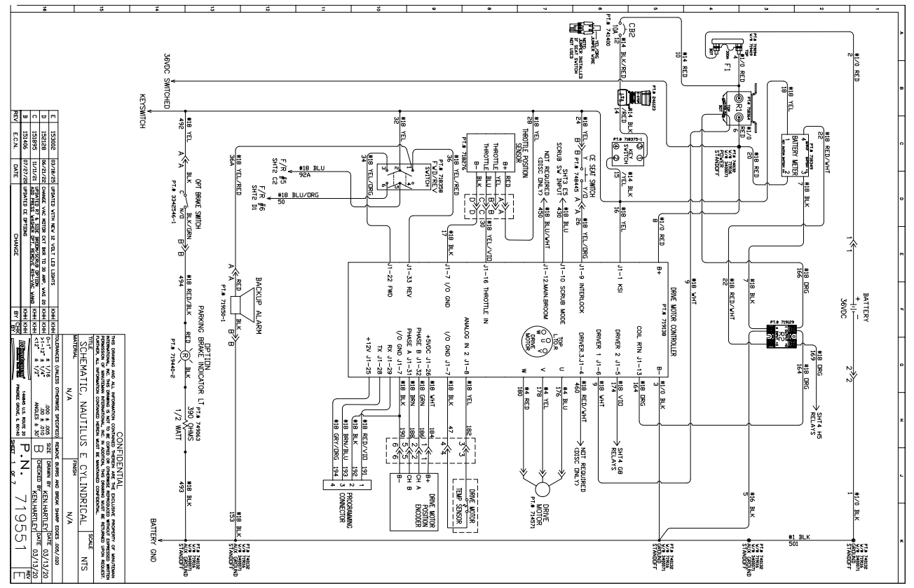
Electrical Box & Wire Routing Pg 1 of 67
*See attached drawings for wiring*

Slide 7
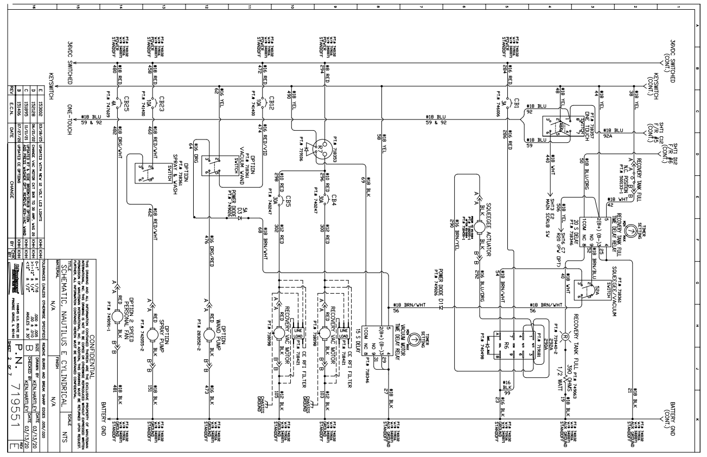
Electrical Box & Wire Routing Pg 2 of 67

Slide 8
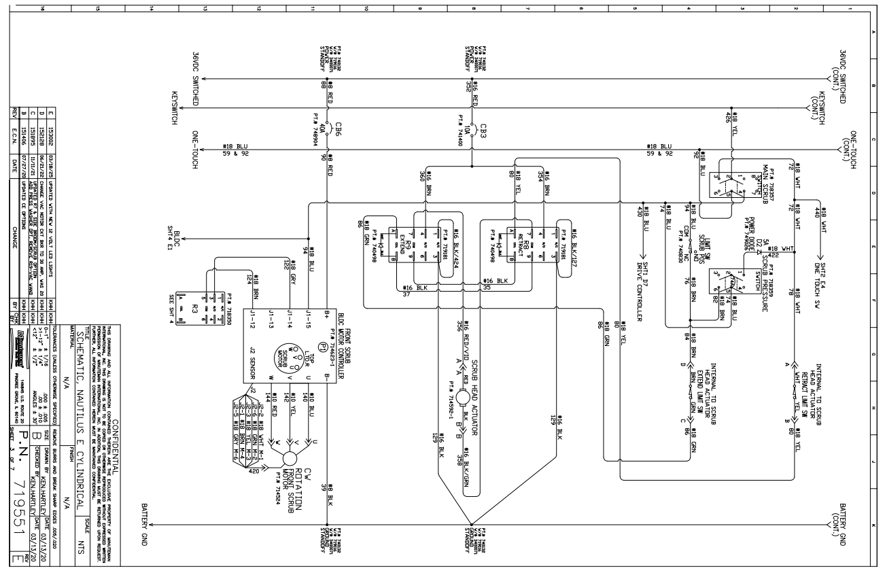
Electrical Box & Wire Routing Pg 3 of 67

Slide 9
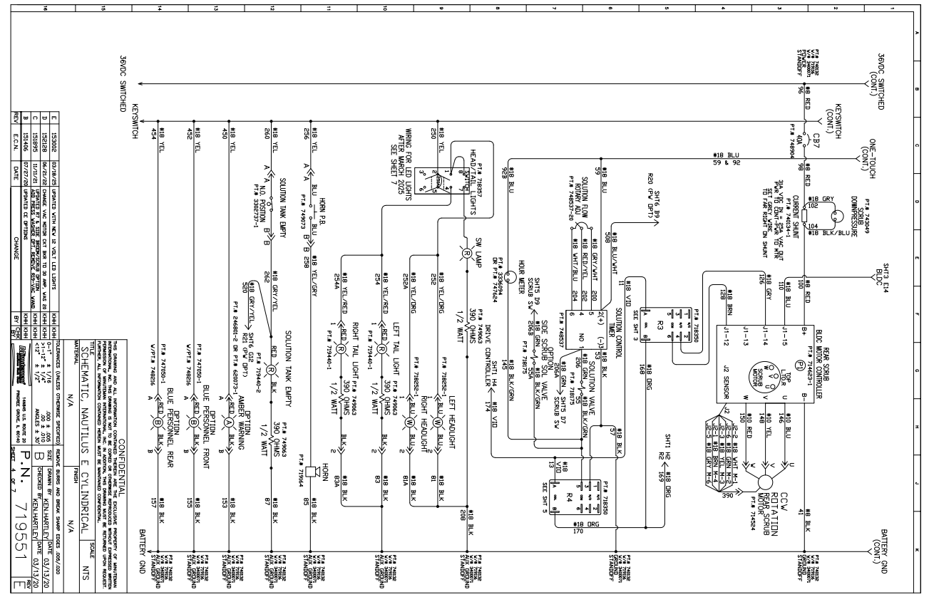
Electrical Box & Wire Routing Pg 4 of 67

Slide 10
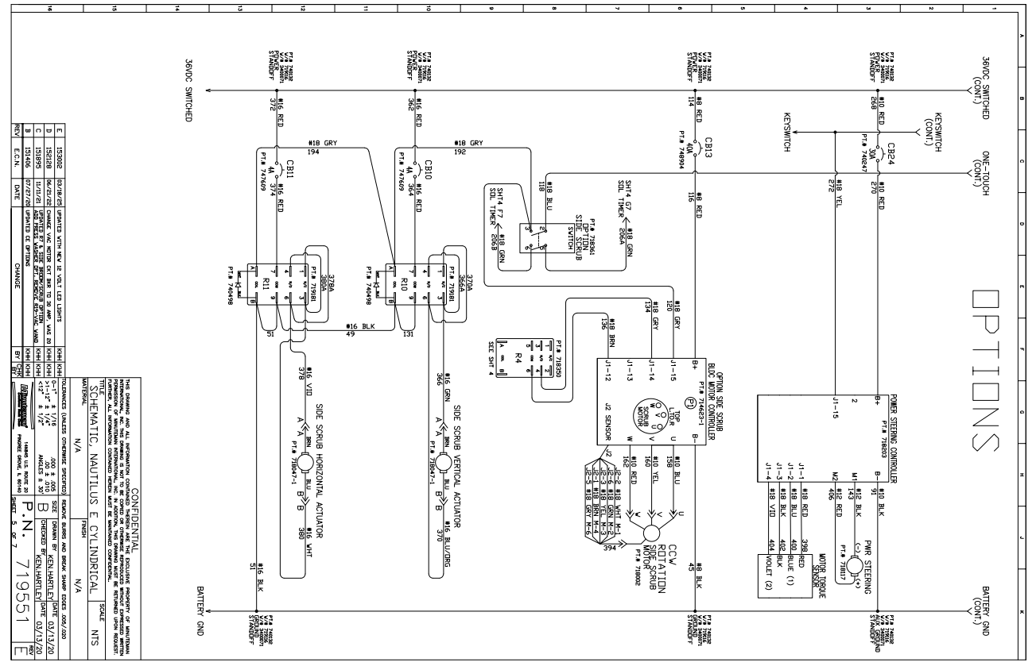
Electrical Box & Wire Routing Pg 5 of 67

Slide 11
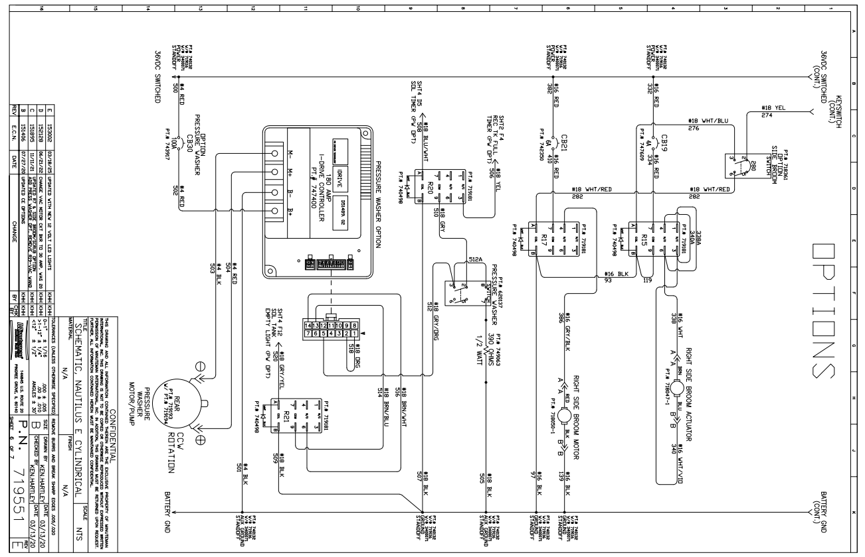
Electrical Box & Wire Routing Pg 6 of 67

Slide 12
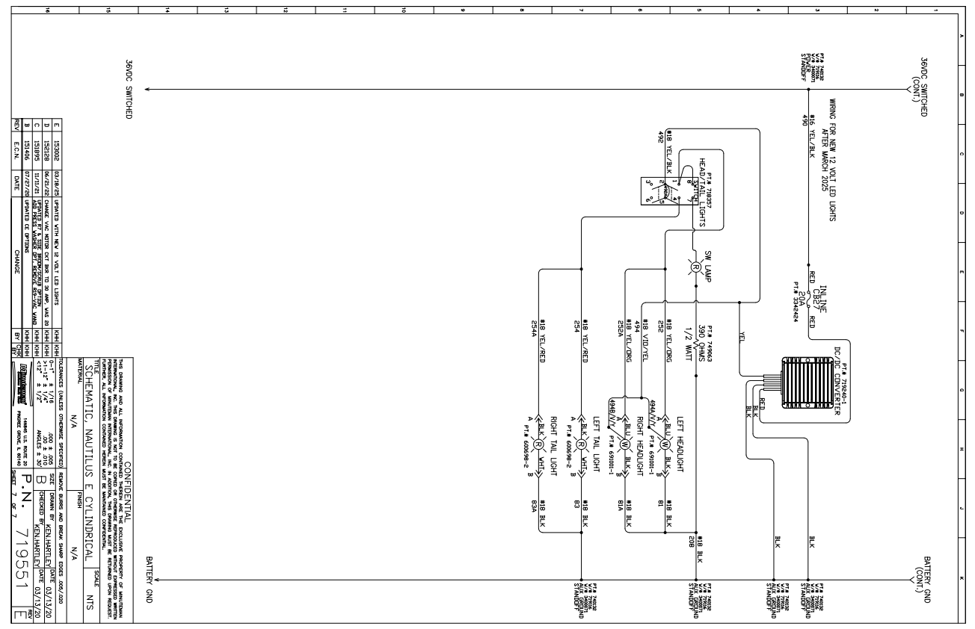
Electrical Box & Wire Routing Pg 7 of 67

Slide 13
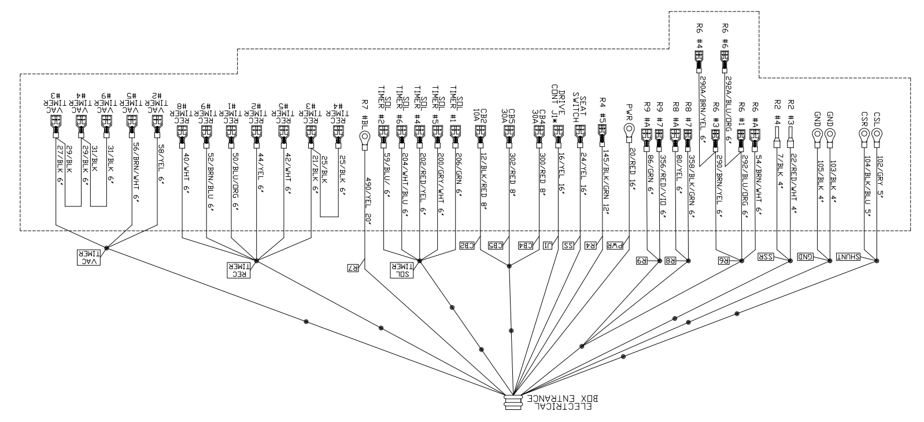
Electrical Box & Wire Routing Pg 8 of 67

Slide 14
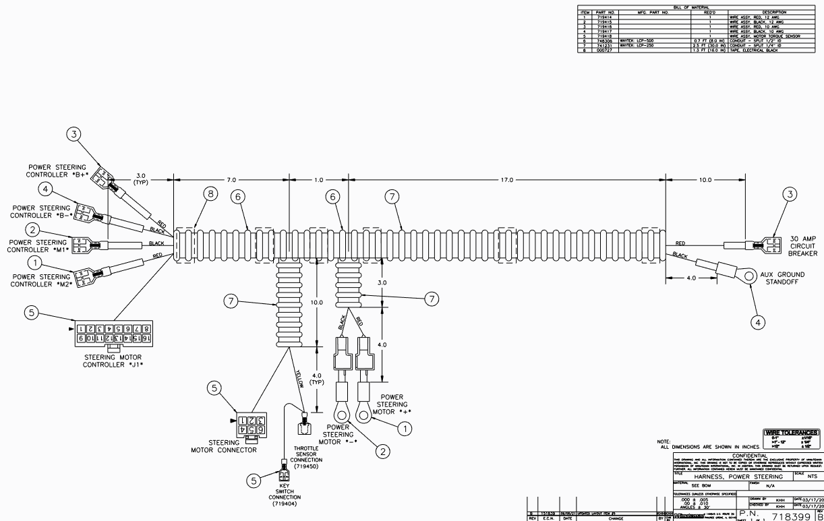
Electrical Box & Wire Routing Pg 9 of 67

Slide 15
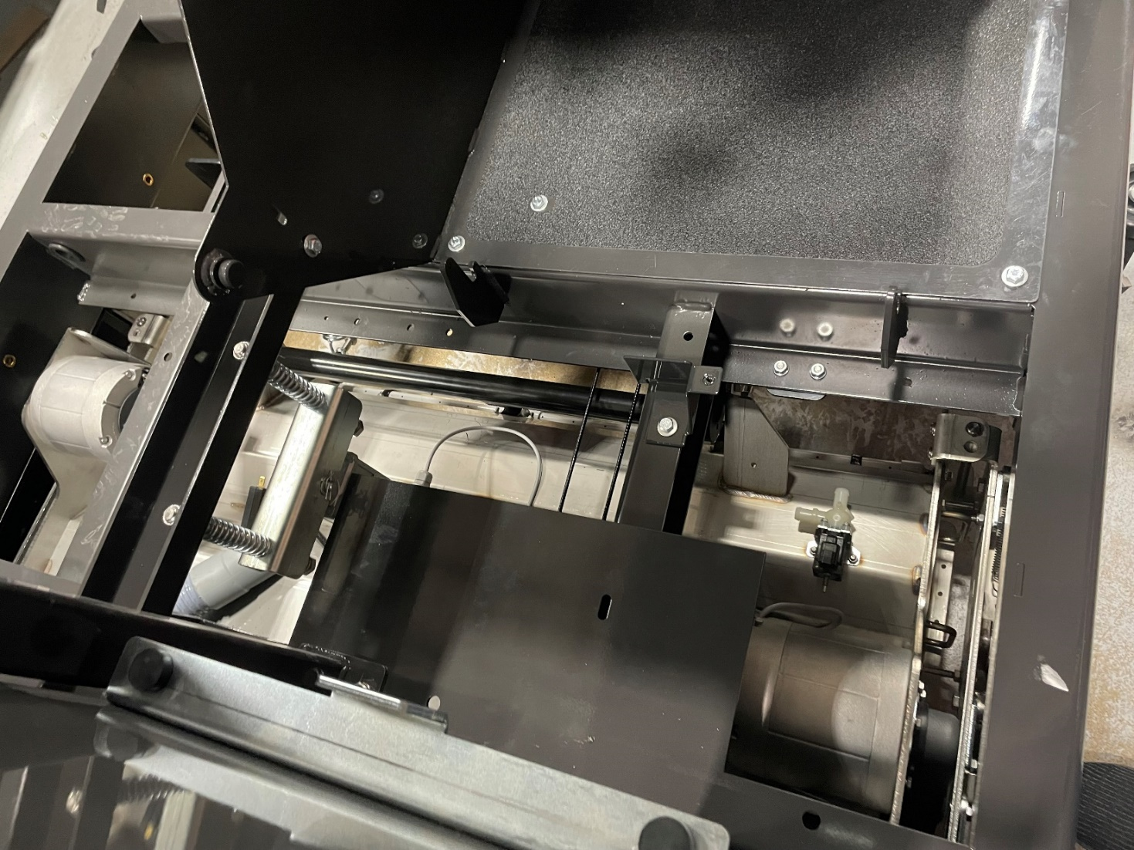
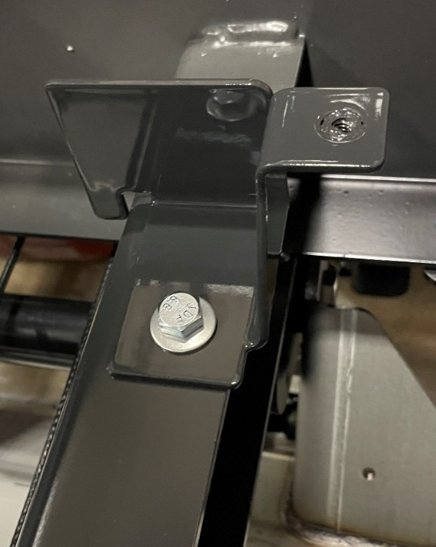
Electrical Box & Wire Routing Pg 9 of 67
719119
717024
3400384
600934
Note: Hand tighten only so electrical box can be adjusted later
Install E-box support bracket (719119) to the frame with screw (717024), conical washer (3400384), and flange nut (600934)

Slide 16
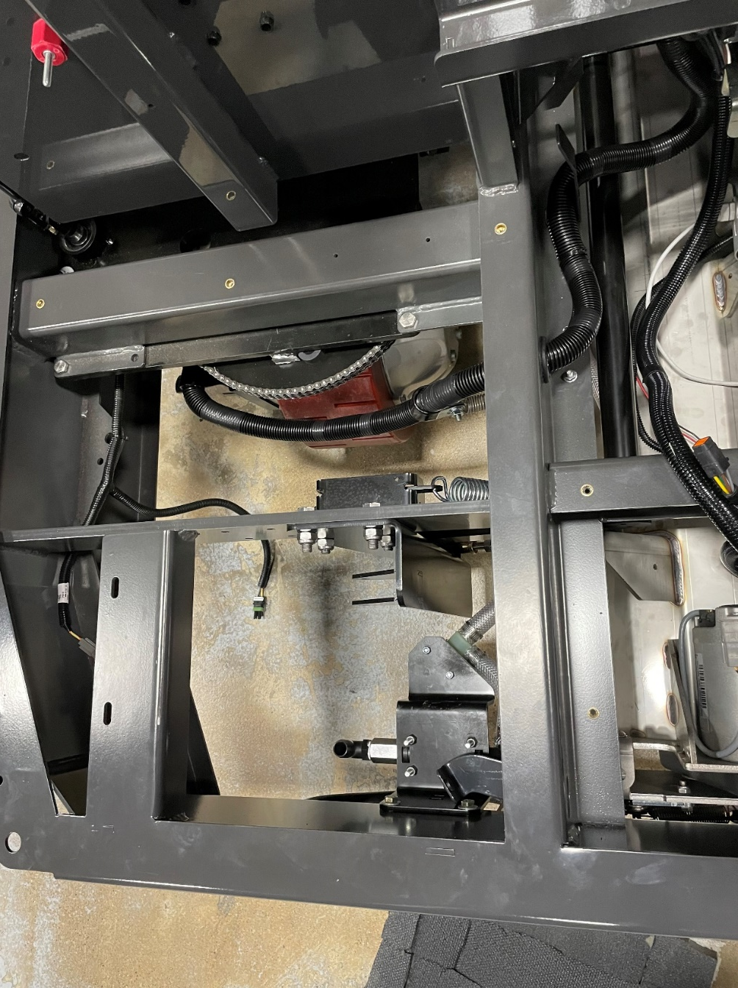
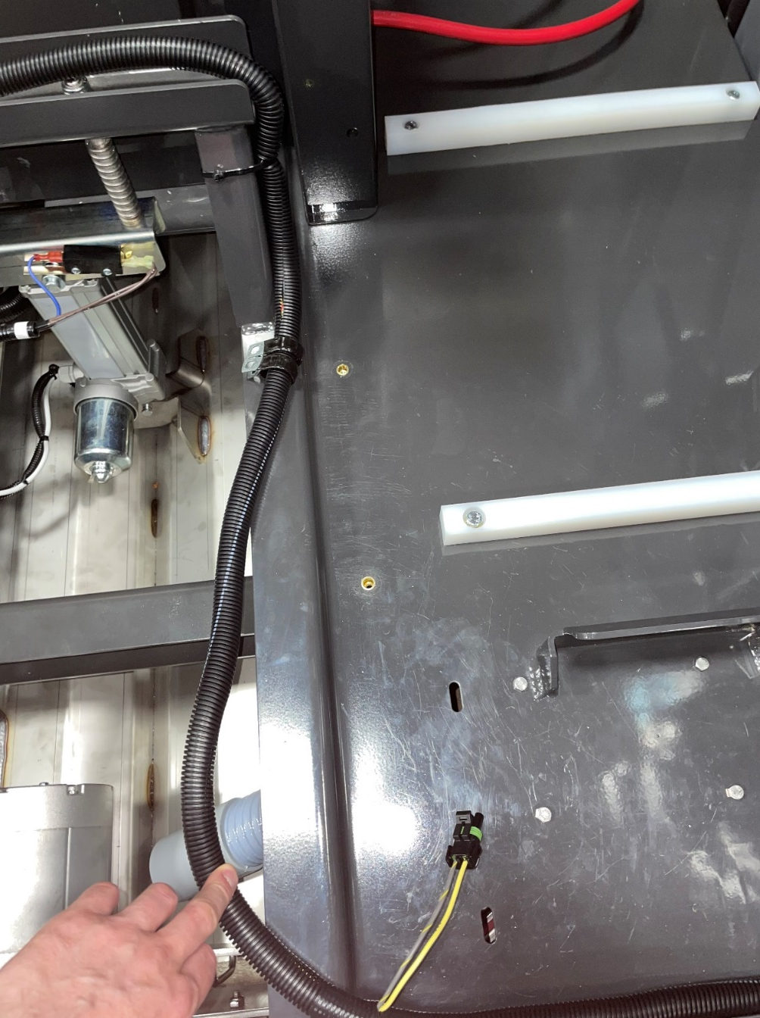
Electrical Box & Wire Routing Pg 10 of 67
(7)730980
Install 7 inserts (730980) in the following locations shown above

Slide 17
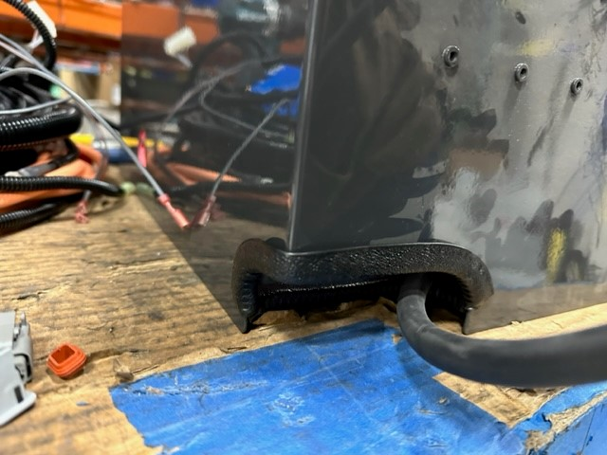
Electrical Box & Wire Routing Pg 11 of 67
3500118
Install edging (3500118) to the corner of the electrical box

Slide 18
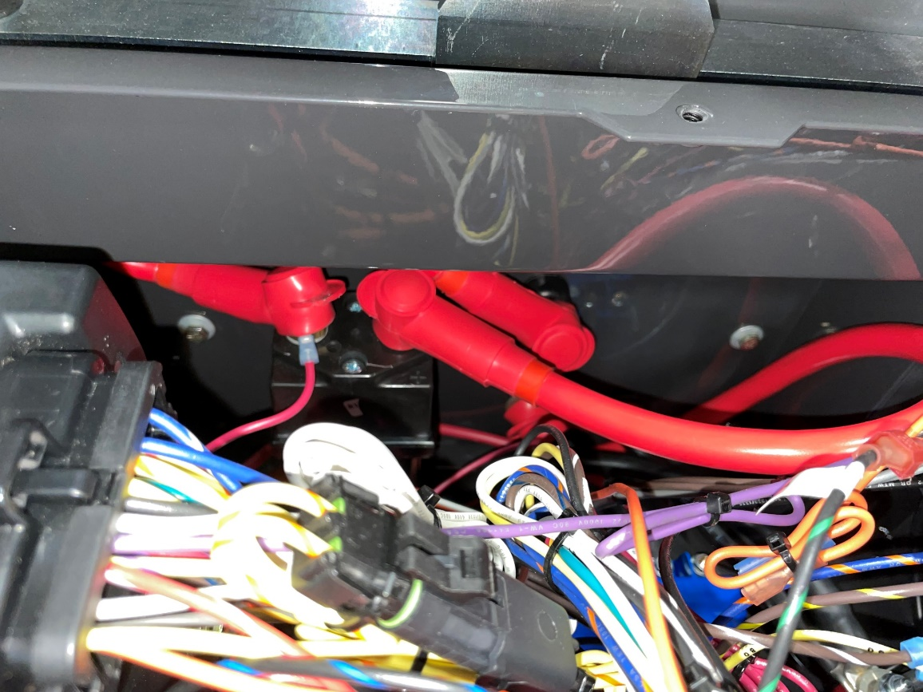
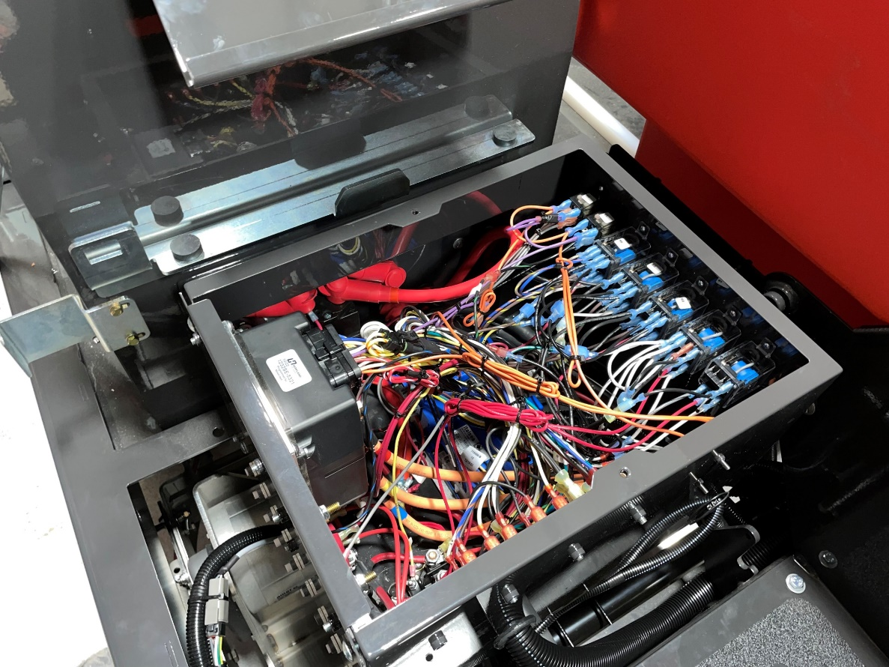
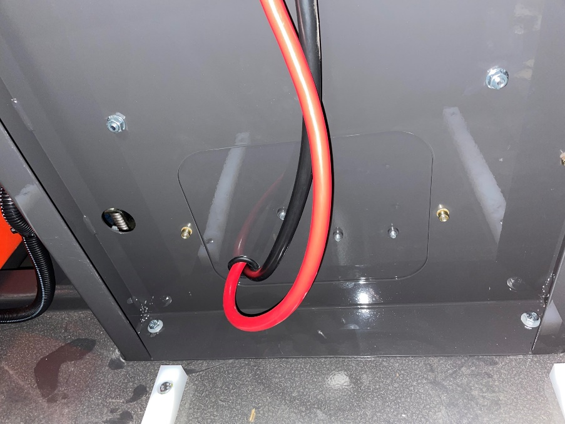
Electrical Box & Wire Routing Pg 12 of 67
(2)11038072
(2)3400383
Align electrical box as shown below, secure with 2 screws (11038072) and 2 conical washers (3400383) to the inserts on the seat back plate

Slide 19
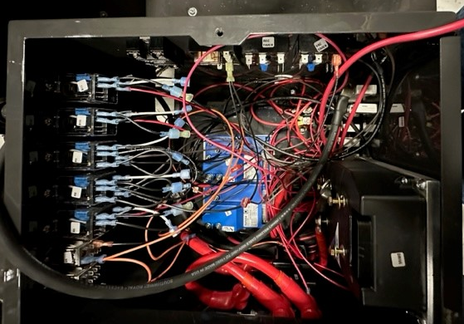
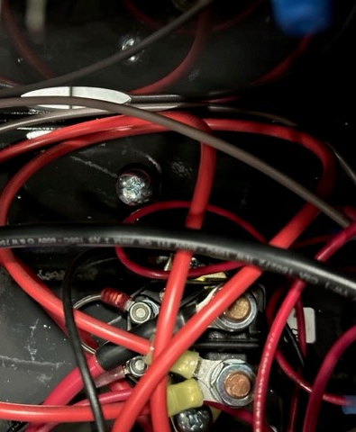
Electrical Box & Wire Routing Pg 13 of 67
Note: Hand tighten only so electrical box can be adjusted later
710180
Secure the bottom of the electrical box with screw (710180) to bracket (719119) that was installed earlier
  Note: Hand tighten only so electrical box can be adjusted later

Slide 20
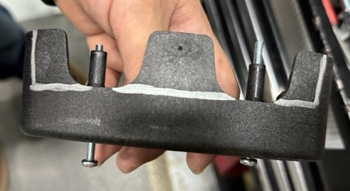
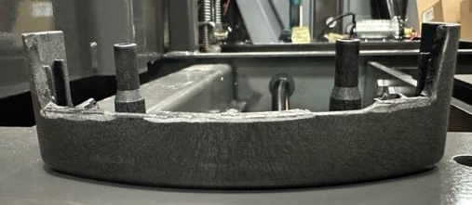
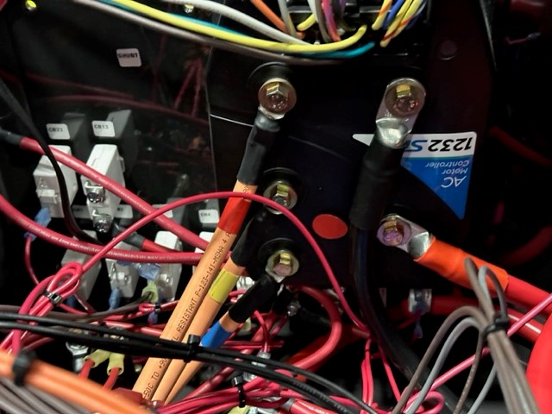
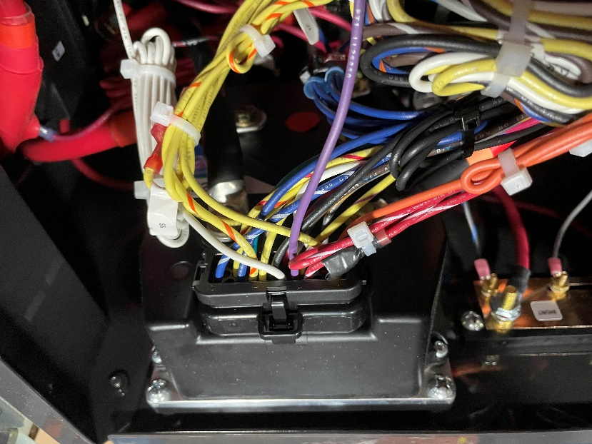
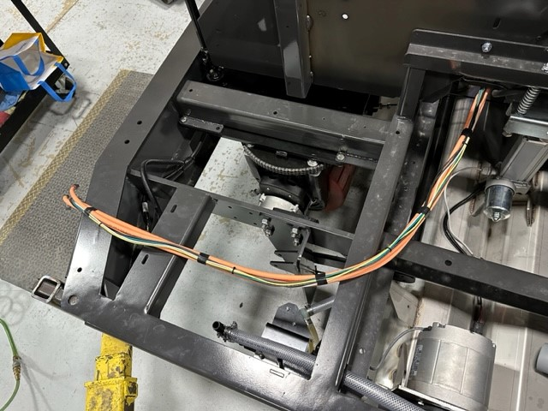
Electrical Box & Wire Routing Pg 14 of 67
Remove cover from drive wheel (714571), mark and cut as shown in the picture above to accommodate drive wheel harness/wire connections
Note: Plug on 719404 needs to be roughly 2” longer in length than orange cables at end
(3)11038098
(3)12332011
Wire Colors:
719401 – Blue
719402 – Yellow
719403 – Red
719404 – Harness
Note: Connects to drive controller in e-box
Connect drive motor harness wires as shown in the bottom left picture making sure the color code on the wires are matching the picture for the different speeds.
  Red = W, Yellow = V, and Blue = U.
Connect harness (719404) to the terminal above the colored cables
Route both the cables and harness together as shown in the bottom right
  Secure cables together for routing
Secure wires with 3 screws (11038098) and 3 washers (12332011)

Slide 21
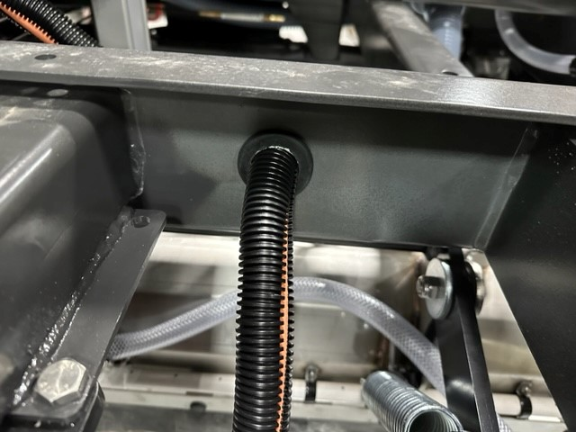
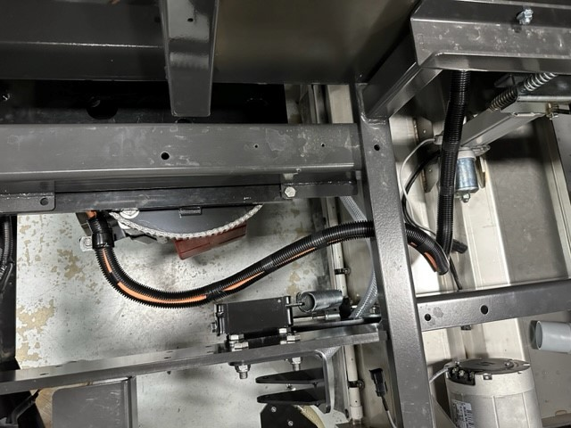
Electrical Box & Wire Routing Pg 15 of 67
718246
210466
Wrap cables and harness in .875” split conduit (210466) and secure with electrical tape
Insert grommet (718246) into frame in the location shown above and route cables/harness through

Slide 22
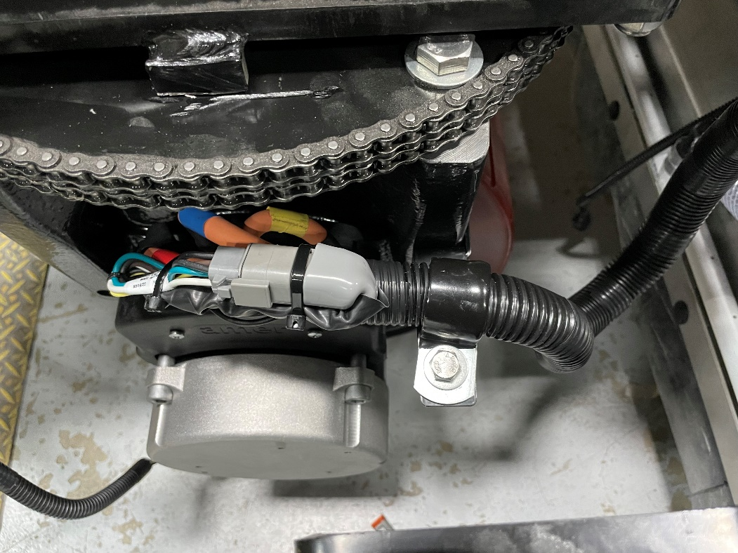
Electrical Box & Wire Routing Pg 16 of 67
3400999
717030
3400384
600934
Install clamp (3400999) on top of bracket (718427 – previously installed in station 1) with screw (717030), washer (3400384), and nyloc nut (600934), zip tie to frame when completed

Slide 23
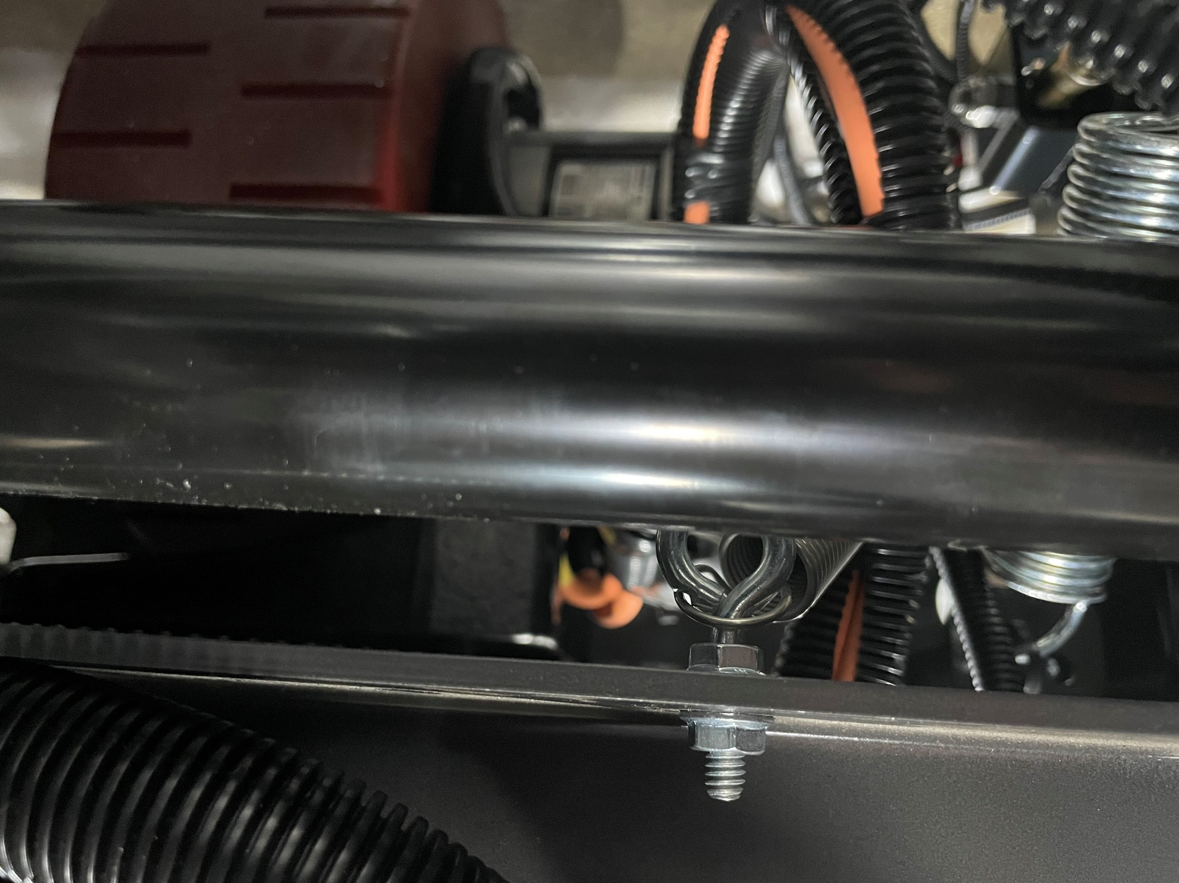
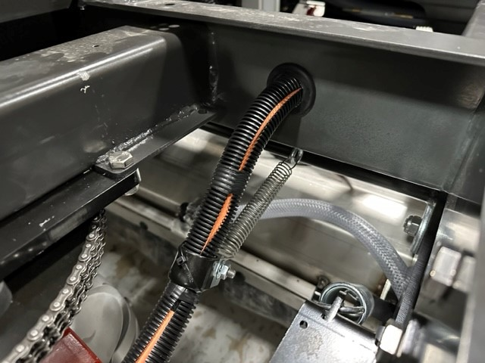
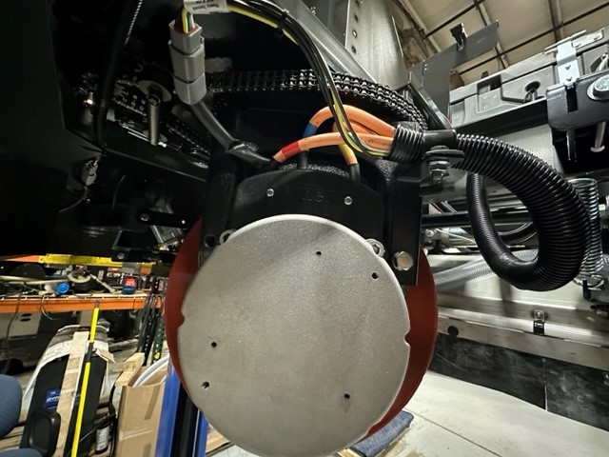
Electrical Box & Wire Routing Pg 17 of 67
712026
(2)711425
3400999
600934
3400384
717030
730619
NOTE: INSTALL WIRE CONNECTIONS BEFORE INSTALLING SPRING &TURN WHEEL ALL THE WAY TO THE RIGHT BEFORE INSTALLING SPRING
Note: if washers and nuts are not included on drive motor wire terminals, use 6 (12022059) nuts and 6 (600947) washers
Connect drive motor harness wires as shown in the picture on the right making sure the color code on the wires are matching the picture for the different speeds.
  Red = W, Yellow = V, and Blue = U. Harness to plug.
Install harness into plug and cables onto drive wheel terminals.
Replace plastic cover onto drive wheel motor that was previously removed
Underneath grommet on frame, install 2 flange nuts (711425) and eye bolt (712026) so that support spring can be installed
Attach clamp (3400999) with screw (717030), conical washer (3400384), and flange nut (600934)
Attach spring (730619) to the clamp and eye bolt for harness & cable support
  NOTE: TURN WHEEL ALL THE WAY TO THE RIGHT BEFORE INSTALLING SPRING
Wire Colors:
719401 – Blue
719402 – Yellow
719403 – Red
719404 – Harness

Slide 24
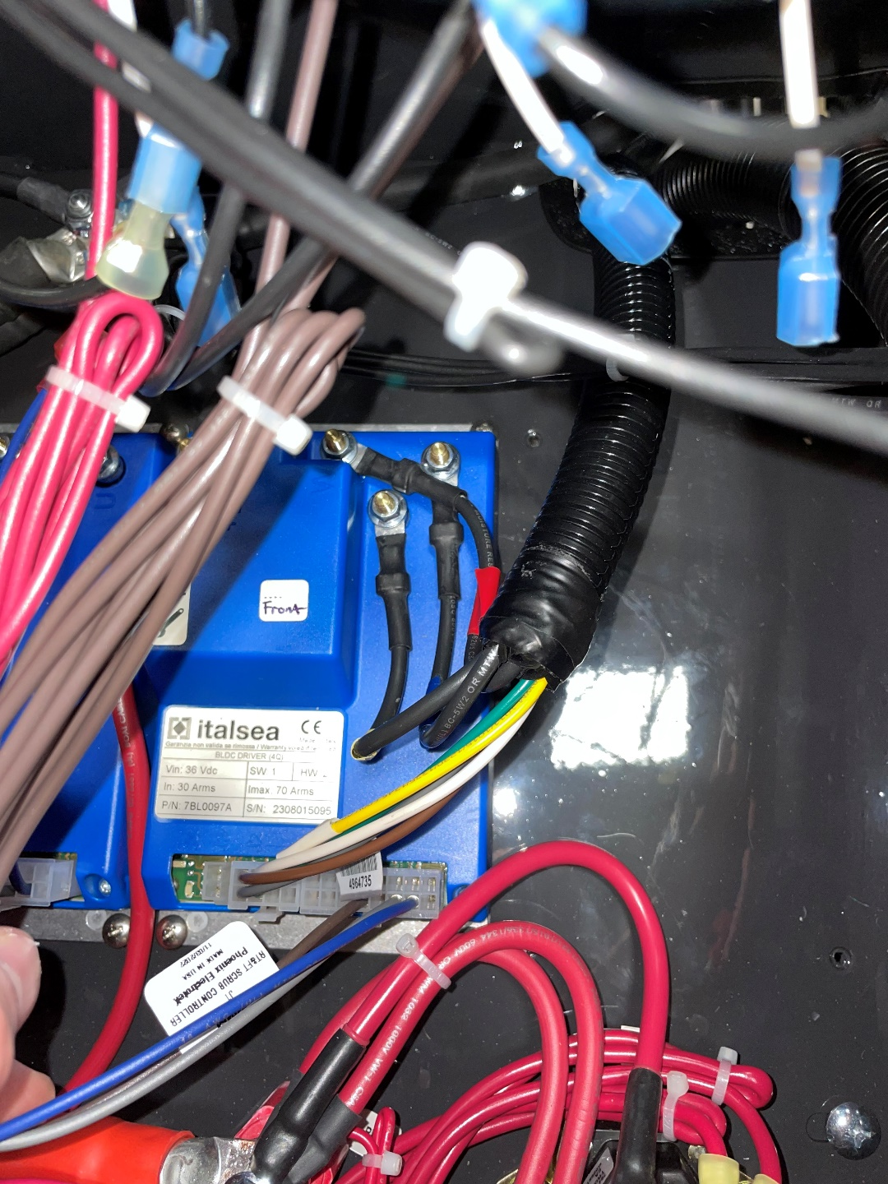
Electrical Box & Wire Routing Pg 18 of 67
719498
Install wire harness (719498) to the blue panel section labeled “front” in the electrical box with the following connections:
  Top = Red, Left = Yellow, and Right = Blue
Connect plug with brown/grey/white/yellow/green wires to the location shown at the bottom of the picture

Slide 25
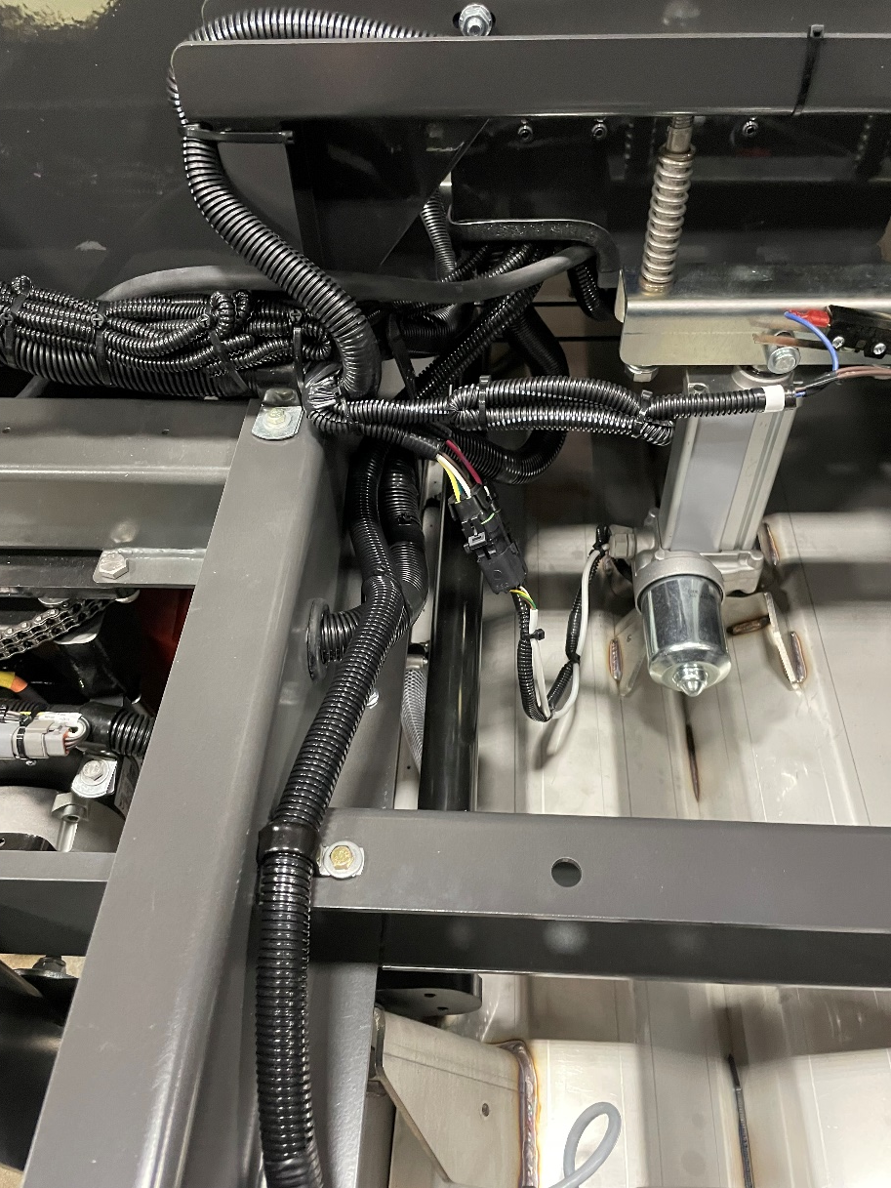
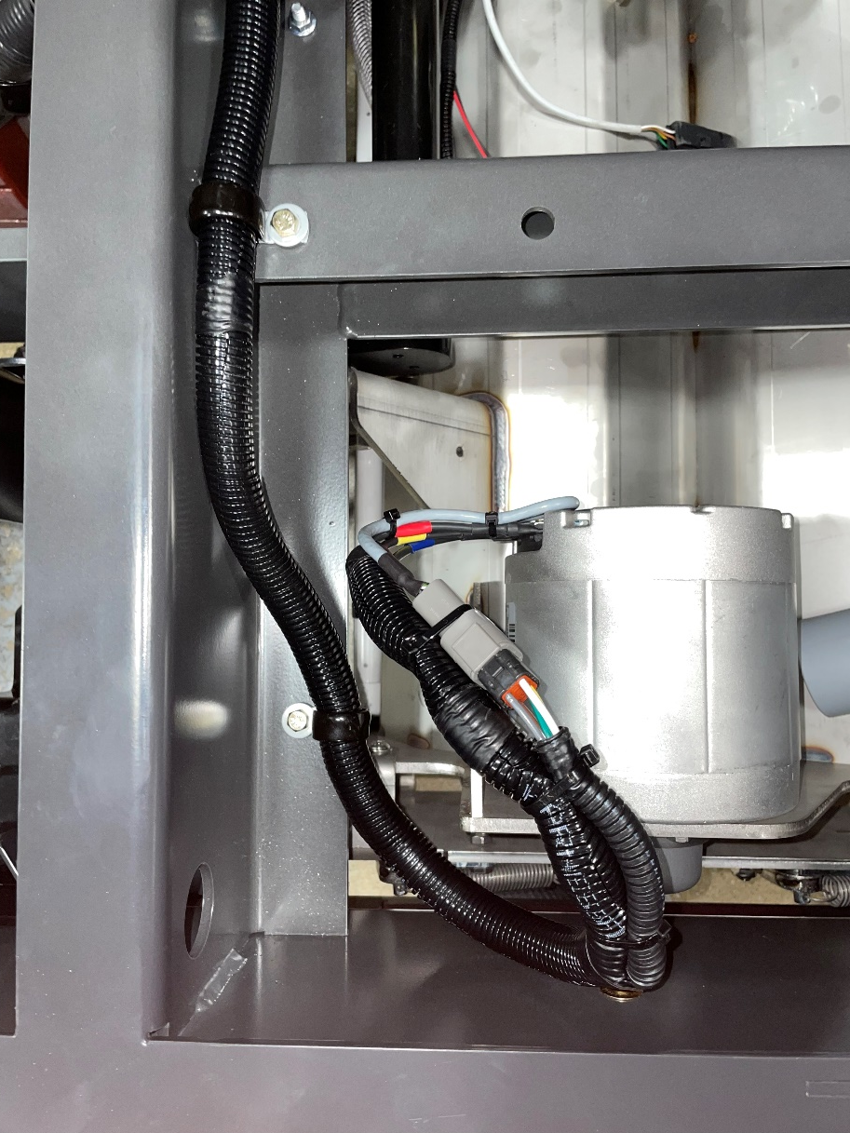
Electrical Box & Wire Routing Pg 19 of 67
(2)731218
(2)11038098
(2)3400383
Route wire harness from electrical box across the frame and to the scrub deck controller motor
Secure with 2 p-clamps (731218), 2 screws (11038098), and 2 conical washers (3400383)

Slide 26
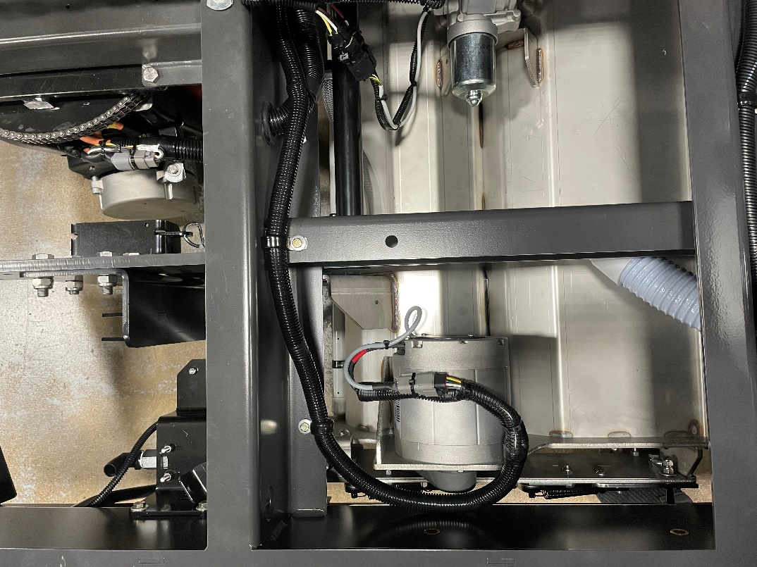
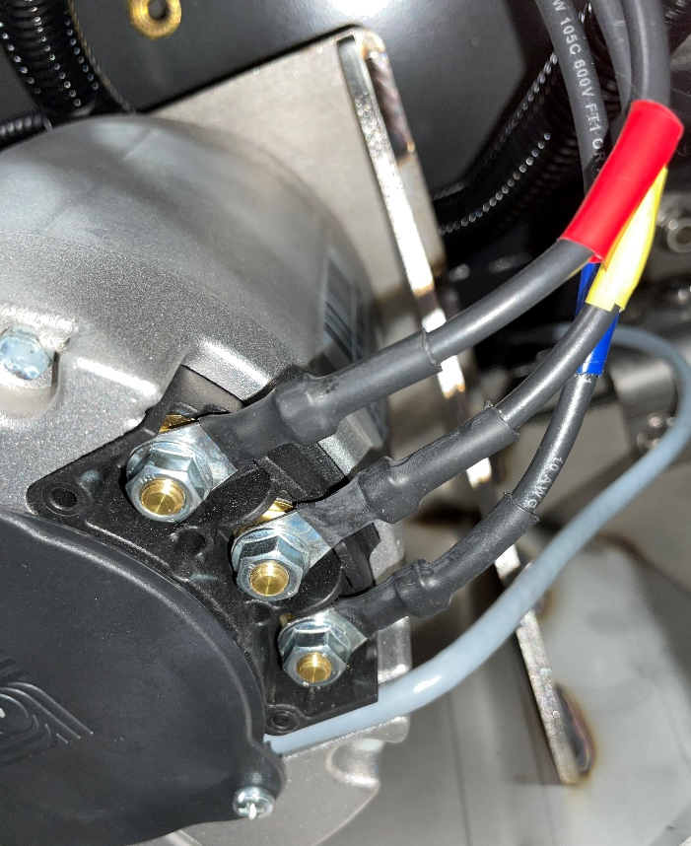
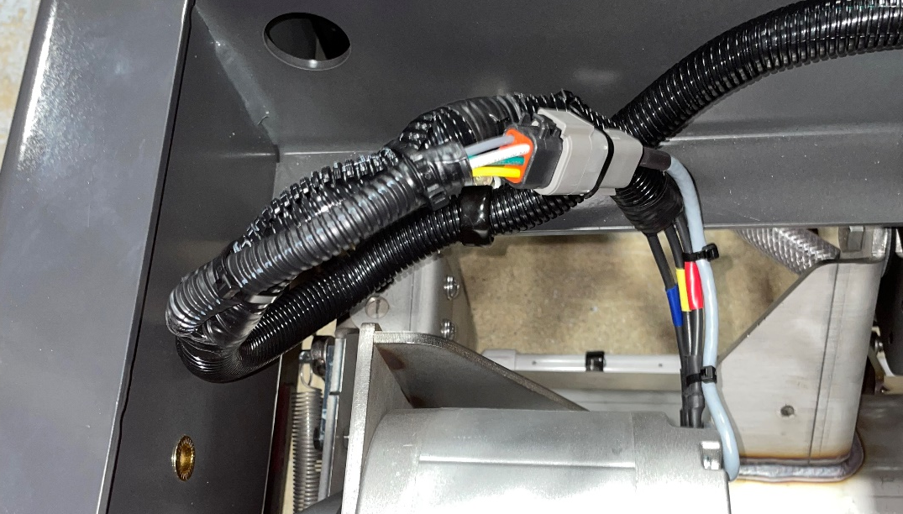
Electrical Box & Wire Routing Pg 20 of 67
719498
Connect wire harness (719498) to the front scrub deck control motor on the left of the scrub deck in the following order as shown above:
  Top = Red, Middle = Yellow, and Blue = Bottom
Connect plug from the harness to the plug on the brush motor as shown on the left

Slide 27
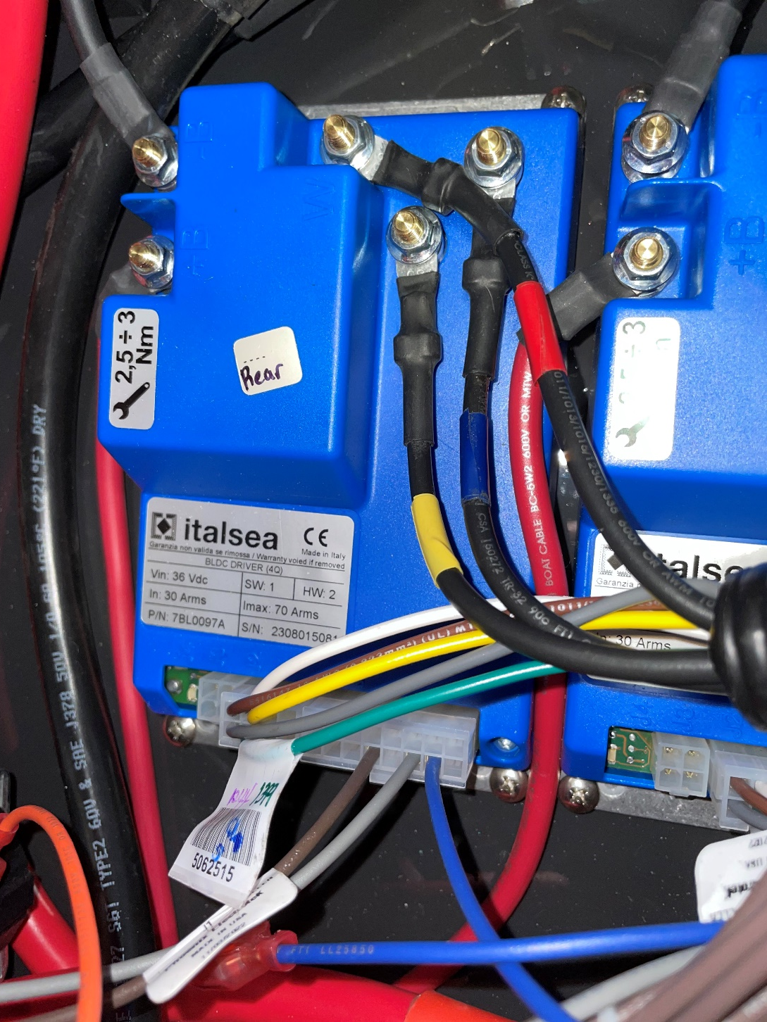
Electrical Box & Wire Routing Pg 21 of 67
Install wire harness (719499) to the blue panel section labeled “rear” with the following connections:
  Top = Red, Left = Yellow, and Right = Blue
Connect plug with brown/grey/white/yellow/green wires to the location shown at the bottom of the picture

Slide 28
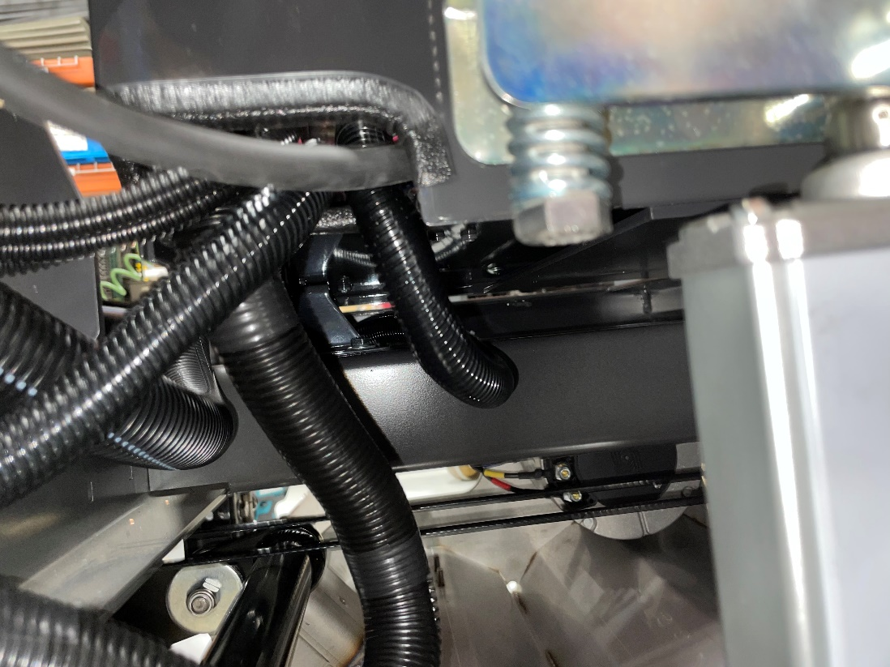
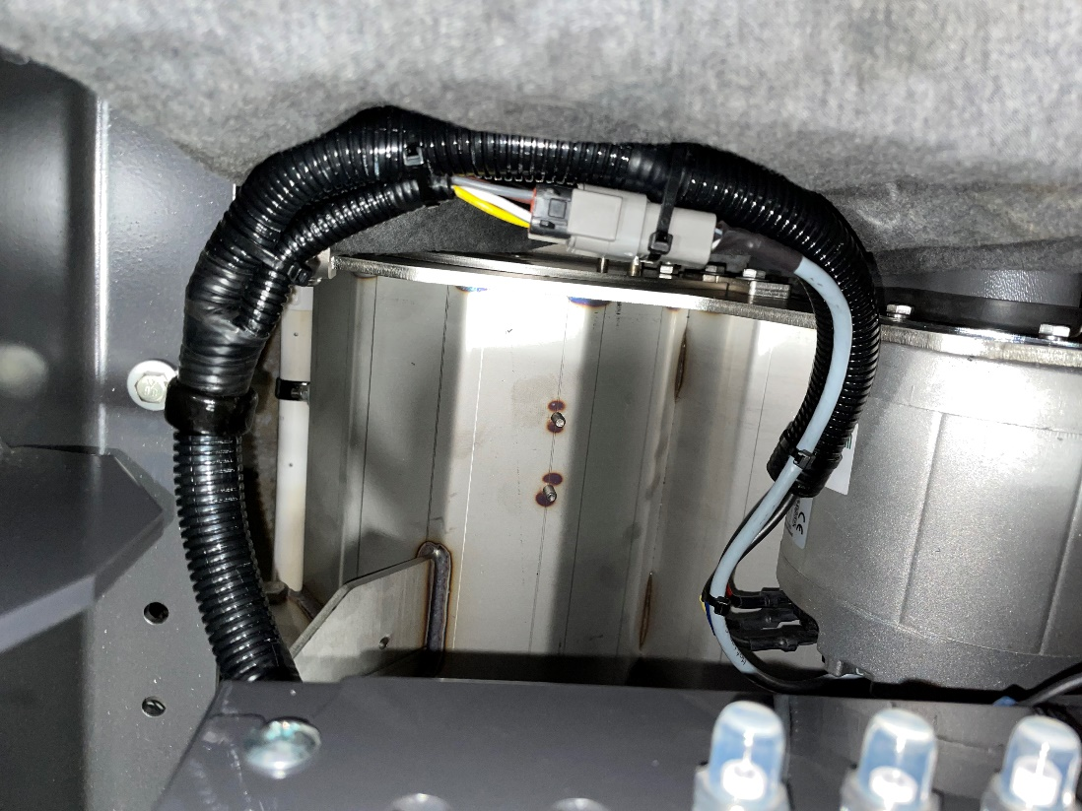
Electrical Box & Wire Routing Pg 22 of 67
731218
11038098
3400383
Route harness (719499) out and underneath electrical box
Secure with p-clamp (731218), screw (11038098), conical washer (3400383), and nut (12040044)

Slide 29
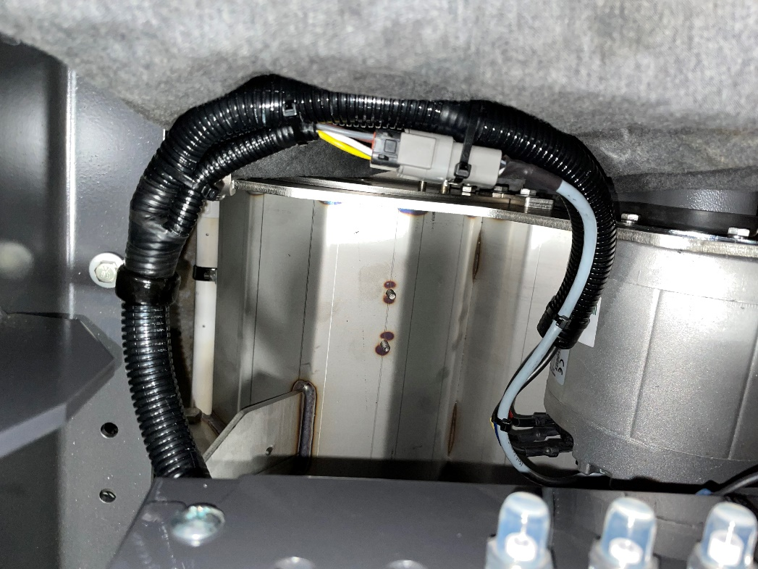
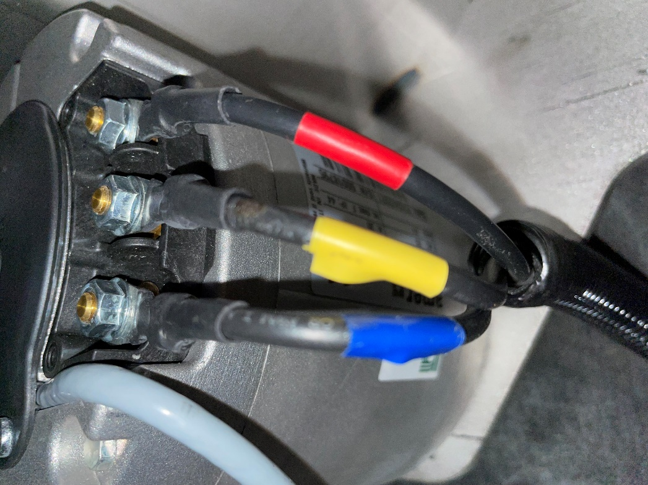
Electrical Box & Wire Routing Pg 23 of 67
Connect harness (719499) to the rear scrub deck control motor located on the right side of the scrub deck with the following connections:
  Top = Blue, Middle = Yellow, and Bottom = Red
  Connect plug on harness to the grey wire coming off of the brush motor

Slide 30
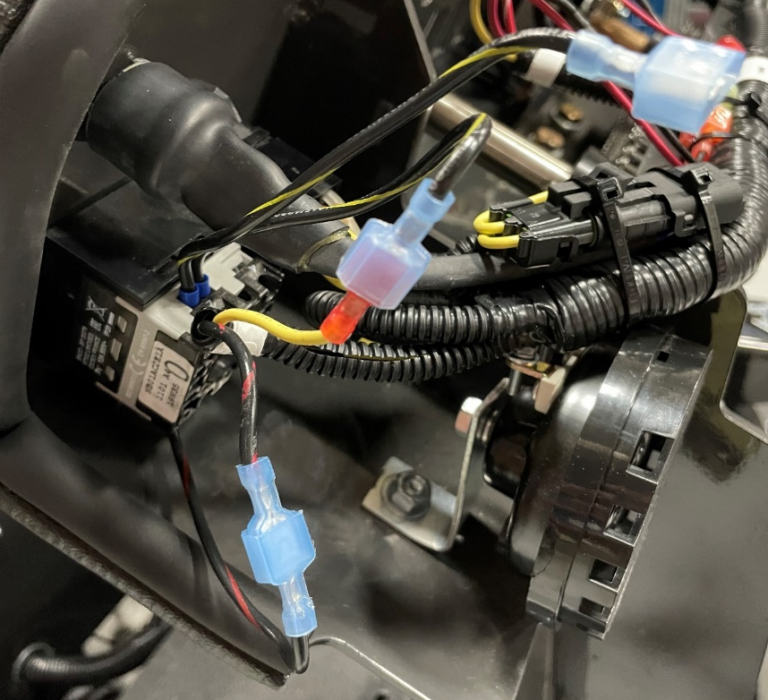
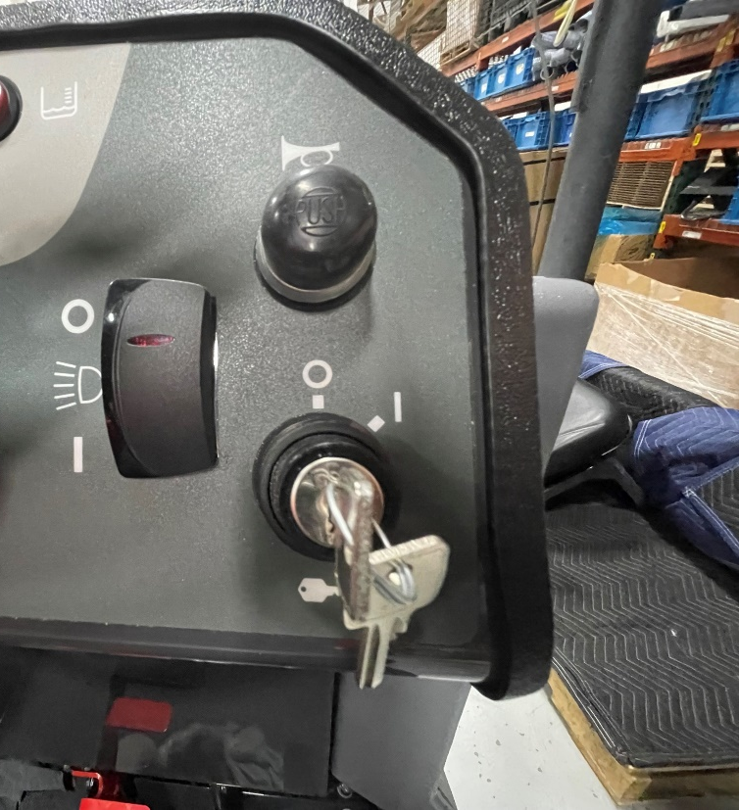
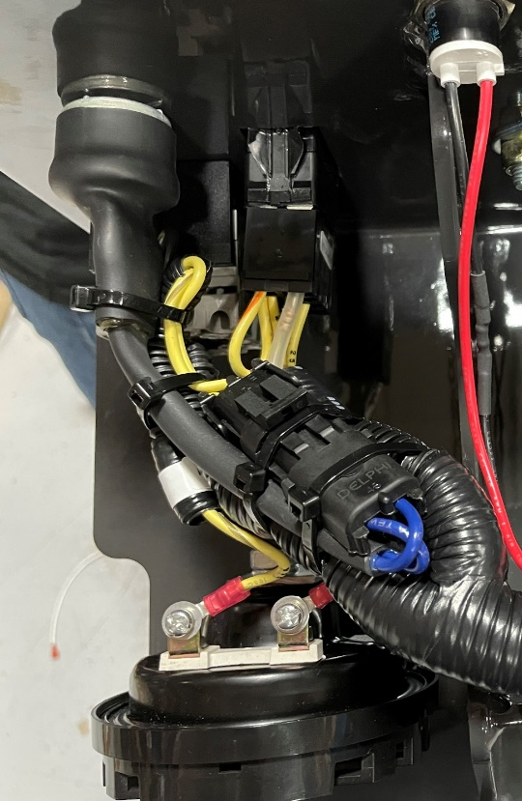
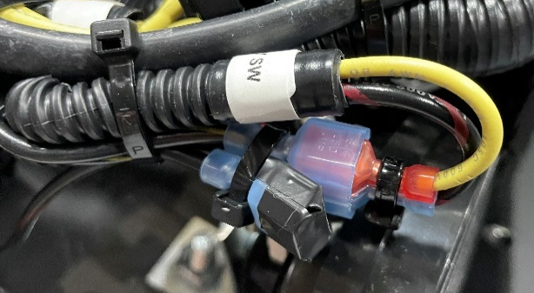
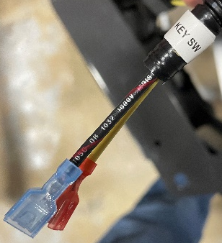
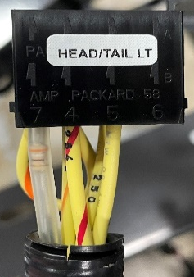


Electrical Box & Wire Routing Pg 24 of 67
Headlight/Tail Light
Horn
Key SW
Key SW
Grab harness (719450) from the vacuums completed previously in station 1 and bring end of harness to front of machine
Connect key switch red/black wire to the red/black wire on harness (719450). Connect key switch yellow/black wire to the yellow wire on harness. Tape off extra yellow/black wire on key switch.
Connect yellow/grey and black wires to terminals on the horn as shown in the picture in the top right and plug in horn switch into the plug with the blue wires
From the harness, plug in Headlight/Tail light branch into the Headlight/Tail Light switch as shown in the top right

Slide 31


Electrical Box & Wire Routing Pg 25 of 67
Connect branch labeled battery gauge in the following order:
  Bottom left = Yellow
  Top left = Red/White
  Bottom right = Red
  Top Right = Black
Connect the two outer lights on the sides of battery gauge with red to grey and black to black

Slide 32






Electrical Box & Wire Routing Pg 26 of 67
Solution Control
E-Stop
E-Stop
12&14
Install E-Stop red/black numbered wires in the location shown in the picture in the top right, make sure they are secured in the E-Stop block on the right side
  Top = 12
  Bottom = 14
Connect solution control plug to the wires coming off of the back of the solution control knob
Solution Control

Slide 33



Electrical Box & Wire Routing Pg 27 of 67
Squee Vac
Main Scrub
Main Scrub
Squee Vac
Connect the main scrub branch from the harness to the main scrub switch on the console
Connect the squeegee vac branch from the harness to the squeegee vac switch on the console

Slide 34




Electrical Box & Wire Routing Pg 28 of 67
One Touch
One Touch
Scrub Down Pressure Gauge
Scrub Down Pressure Gauge
On the rear of the scrub down pressure gauge, connect the grey wire to the left terminal and the black/blue wire to the right terminal
Plug in the one touch branch of the harness to the rear of the green switch on the console

Slide 35


Electrical Box & Wire Routing Pg 29 of 67
Scrub Pressure
Scrub Pressure
Connect scrub pressure branch off of the harness to the scrub pressure switch on the console

Slide 36





Electrical Box & Wire Routing Pg 30 of 67
FWD/REV
Connect the FWD/REV branch from the harness to the FWD/REV switch on the console
From the harness, connect the blue wire to the left terminal of the hour meter and the green/black wire to the right terminal
Hour Meter
FWD/REV
Hour Meter

Slide 37



Electrical Box & Wire Routing Pg 31 of 67
719161
740247
Connect red wire (719161) on lower terminal of 30A circuit breaker (740247) to the power standoff in electrical box (previously done in sub assembly)

Slide 38

Electrical Box & Wire Routing Pg 32 of 67
718399
719213
Connect red wire (719213) to top terminal of circuit breaker and route to the power steering harness (718399) that is labeled 30A circuit breaker. (wire diagram on pg 12 of book/pg 8 of wire routing)
Connect black aux standoff wire from power steering harness (718399) to the aux ground standoff on the side of the console

Slide 39



Electrical Box & Wire Routing Pg 33 of 67
(2)713001
(2)3400103
(2)731234
(2) 3400082
(2) 3400045
718203
Mount controller 718203 by securing to console with 2 (3400045) screws and 2 (3400082) nuts
Install standoffs for controller cover with 2 (713001) screws, 2 (3400103), (2) 731234 standoffs
Connect all wires from harness 718399 to the corresponding terminals on the controller (wires are labeled (+B, -B, M1, M2)
Connect the branch of wires (red and black) from harness (718399) to the power steering motor as shown in the picture on the right (wire diagram on pg 12 of book/pg 8 of wire routing)

Slide 40

Electrical Box & Wire Routing Pg 34 of 67
Key switch connection
(extra, see note below)
Power steering connection
Connect the branch of wire from power steering harness (718399) to the power steering motor as shown above.
Connect the yellow wire from the same branch off power steering harness to the key switch wire as shown above (extra in case other options are present)

Slide 41

Electrical Box & Wire Routing Pg 35 of 67
731276
731275
711563
Install seal (731276) around the edge of controller cover (731275)
Install cover (731275) over controller (718203) and secure with 2 (711563) wing nuts

Slide 42


Electrical Box & Wire Routing Pg 36 of 67
Auxiliary Ground Standoffs
Zip tie harness to console on the cable tie mounts
Connect black ground cable from the electrical box to the grounding standoff on the console
Connect AUX Ground Standoffs to the grounding standoff and secure with nut (711425)on the console as shown
Secure yellow power wires to the harness if not used

Slide 43


Electrical Box & Wire Routing Pg 37 of 67
Headlight Harness
Connect the HEAD LT HARN branch from harness (719450) to the branch of the headlight harness labeled MAIN HARNESS

Slide 44



Electrical Box & Wire Routing Pg 38 of 67
(2)11038098
(2)713527 (2)3400383
Route SOL VALVE branch of harness (719450) as shown in the top left picture and connect to the solution valve as shown in the top right picture
Secure harness with 2 p-clamps (713527), 2 screws (11038098), and 2 conical washers (3400383)

Slide 45




Electrical Box & Wire Routing Pg 39 of 67
Note: Not used*
Route these three branches of cable from harness (719404) out of the electrical box and up the side of the console as shown above
  Note: BLUE AND LIGHT BLUE STRIPED WIRE CIRCLED IN THE TOP MIDDLE PICTURE IS NOT USED, SOLID BLUE ON SAME BRANCH OF WIRE HARNESS IS USED*

Slide 46

Electrical Box & Wire Routing Pg 40 of 67
FWD/REV
(719450)
719404
In between the hour meter wires and the FWD/REV plug on harness (719450), connect the yellow/orange to the other yellow/orange and the yellow/red to the other yellow/red

Slide 47


Electrical Box & Wire Routing Pg 41 of 67
Note: Not used*
Used in this step
719404
Connect the solid blue wire coming from harness (719404) to the solid blue wire coming off of the MAIN SCRUB branch of harness (719450)
MAIN SCRUB
(719450)

Slide 48



Electrical Box & Wire Routing Pg 42 of 67
719404
(719450)
With the branch of (719404) that has the yellow wire and plug labeled THROTTLE POS CONTROLLER, connect the yellow wire to the yellow wire on harness (719450) labeled THROTTLE SENSOR
(719404)

Slide 49


Electrical Box & Wire Routing Pg 43 of 67
719404
(2)172454
(2)11038098
(2)3400383
(2)12040044
THROTTLE POS CONTROLLER
(17526120)
Neatly secure loose wire with zip ties
Run THROTTLE POS CONTROLLER branch of harness (719404) and connect to plug coming off of controller, secure plug with zip tie and cable mount (17526120)
Secure harness (719404) with 2 p-clamps (172454), 2 screws (11038098), 2 conical washers (3400383), and 2 nyloc nuts (12040044)

Slide 50


Electrical Box & Wire Routing Pg 44 of 67
From the main harness, hook up the branch labeled LIMIT SWITCH to the switch on the scrub deck actuator with the blue cable to the left terminal and the brown cable to the lower right terminal on the switch as shown above

Slide 51


Electrical Box & Wire Routing Pg 45 of 67
Neatly secure loose wire with zip ties
Deck Actuator
Connect the deck power to the red and black cable coming off of the actuator
Connect the deck actuator to the grey cable coming off of the actuator
Deck Power

Slide 52



Electrical Box & Wire Routing Pg 46 of 67
Connect the blue wires from harness (719404) to the blue wires circled in the pictures on the right

Slide 53




Electrical Box & Wire Routing Pg 47 of 67
#54
From harness (719450), cut the female QC off of the brown/white wire and replace it with larger female QC (740366)
  Brown/white wire is located on the “R6” branch of (719450)
Connect brown/white wire to the R6 relay white wire

Slide 54



Electrical Box & Wire Routing Pg 48 of 67
#292A
#290
#292
#290A
Plug the rest of the wires from the R6 branch into the R6 relay in the following order:
  Dual orange/blue (292) = bottom left (1)
  Dual brown/yellow (290A) = next to dual orange/blue on bottom (4)
  Singular brown/yellow connected to dual (290)= top left (3)
  Singular orange/blue (292A) = next to singular brown yellow on top (6)

Slide 55



Electrical Box & Wire Routing Pg 49 of 67
#80
From harness (719450), cut the female QC off of the yellow wire and replace it with larger female QC (740366)
  Yellow wire is located on the “R8” branch of (719450)
Connect yellow wire (80) to the R8 relay white wire (A)

Slide 56



Electrical Box & Wire Routing Pg 50 of 67
#358
Plug the green/black wire (358) from the R8 branch into the R8 relay on the bottom directly next to the white wire (7)

Slide 57



Electrical Box & Wire Routing Pg 51 of 67
#86
From harness (719450), cut the female QC off of the green wire and replace it with larger female QC (740366)
  Green wire is located on the “R9” branch of (719450)
Connect green wire (86) to the R9 relay white wire (A)

Slide 58


Electrical Box & Wire Routing Pg 52 of 67
#356
Plug the red/purple wire (356) from the R9 branch of (719450) into the R9 relay on the bottom directly next to the white wire (7)

Slide 59



Electrical Box & Wire Routing Pg 53 of 67
#145
Plug the green/black wire (145) from the R4 branch of (719450) into the R4 relay on the bottom directly below the purple wire on the right (5)

Slide 60


Electrical Box & Wire Routing Pg 54 of 67
#103
#105
In electrical box, connect the black GND wires from harness (719450) to the ground standoff as shown in the picture

Slide 61

Electrical Box & Wire Routing Pg 55 of 67
Route the SSR branch from harness (719450) to R2 connecting the red/white wire (22) to the +3 terminal and the black wire (7) to the 4 terminal
#22
#7

Slide 62



Electrical Box & Wire Routing Pg 56 of 67
#206
#204
#200
#202
#59
Install SOL TIMER branch from harness (7179450) in the following order onto the SOL TIMER:
  Top right (1) = Green
  Below green (6) = White/blue
  Below white/blue (5) = Grey/white
  Below grey/white (4) = Red/yellow
  Left terminal (2) = Blue

Slide 63

Electrical Box & Wire Routing Pg 57 of 67
Black #21 w/ Clear Female QC
#44
#50
#42
Black #25 w/ Red Female QC
#40
#52
Install REC TIMER branch from harness (7179450) in the following order onto the REC TIMER:
  Top right (1) = Blue (50)
  Left of blue (2) = Yellow (44)
  Left of yellow (3) = Black (21)
Below black (5) = White (42)
Below white (4) = Black (25)
Bottom right (8) = White (40)
Next to white on bottom right (9) = Brown/blue (52)

Slide 64


Electrical Box & Wire Routing Pg 58 of 67
Black #27/29 w/ Clear Female QC
#58
#56
Black #29/31 w/ Clear Female QC
Black #31 w/ Red Female QC
Install VAC TIMER branch from harness (7179450) in the following order onto the VAC TIMER:
  Top middle (2) = Yellow (58)
  Left of yellow (3) = Black (27/29)
  Below black (5) = Brown/white (56)
Below brown white (4) = Black (29/31)
Bottom left (9) = black (31)

Slide 65


Electrical Box & Wire Routing Pg 59 of 67
#490
Connect the R7 (490) wire from the harness (719450) to the bottom left terminal on the R7 contactor

Slide 66



Electrical Box & Wire Routing Pg 60 of 67
CB4
CB2
CB5
CB2
#12
CB4
#300
CB5
#302
Connect the CB2, CB4, and CB5 branches of harness (719450) to the top terminals on the corresponding circuit breaker as shown in the pictures above

Slide 67


Electrical Box & Wire Routing Pg 61 of 67
#16
Connect the J1 (16) branch of harness (719450) to the solid yellow wire coming out of (719404)

Slide 68


Electrical Box & Wire Routing Pg 62 of 67
#16
Connect the SS (16) branch of harness (719450) to the solid yellow wire coming off of the SEAT SWITCH connector

Slide 69



Electrical Box & Wire Routing Pg 63 of 67
#20
Connect the PWR (20) wire from harness (719450) to the power terminal located on the bottom of the electrical box

Slide 70


Electrical Box & Wire Routing Pg 64 of 67
#9
Connect the white (9) wire from harness (719404) to the top right terminal on R1

Slide 71

Electrical Box & Wire Routing Pg 65 of 67
Connect purple wire from harness (719404) to the top right terminals of R4 & R3 as shown in the picture.

Slide 72

Electrical Box & Wire Routing Pg 66 of 67
Tape off the red/white wire coming off of harness (719404)
Tape off the third branch of the purple wire coming out of the R3 (A) terminal
Tape off the third branch of the orange wire coming out of the R3 (B) terminal

Slide 73


Electrical Box & Wire Routing Pg 67 of 67
#102
#104
Install the shunt branch of (719450) with the black/blue (104) wire on the right terminal and the grey (102) wire on the middle terminal as shown above on the shunt

Slide 74

Leveling Scrub Deck and Testing Pg 1 of 2
Adjust linkages so that the scrub deck is leveled, see next page for test results of level scrub deck (this may need adjusting multiple times until lines are even)

Slide 75

Leveling Scrub Deck and Testing Pg 2 of 2
Using chalk spray, spray lines on the ground and run machine after each adjustment
  Horizontal lines should look like the above once full adjusted

Slide 76
Battery Bars Material List and Locations
Component | Object Description | Usage Qty | Storage Bin
719484 | BATTERY BAR | 3 | A1912E03
600919 | SCR-HH M8-1.25 X 40 ZP CLASS 8.8 | 6 | FAS07D02
12310041 | WASHER-FLAT M8.4 X 16 X 1.6 ZP | 6 | FAS01D10

Slide 77

Battery Bars Pg 1 of 1
(3)719484
(6)600919
(6)12310041
Install 3 battery bars (719484) onto top of frame with 6 screws (600919) and 6 washers (12310041).
  Frame is already threaded for screws

Slide 78
Rear Squeegee List and Locations
Component | Object Description | Usage Qty | Storage Bin
B5-TG-S703 | REAR SQUEEGEE | 1
730985 | ASSEMBLY, SQUEEGEE HOSE | 1 | A1806H02
731144 | CLAMP - SCREW 2.25 to 3.25 DIA 201SS | 1 | MIN04F02

Slide 79


Rear Squeegee Pg 1 of 1
731144
730985
B5-TG-S703
Secure rear squeegee onto rear bumper as shown and tighten knobs (previously installed on sub)
Install hose (730985) onto rear squeegee as shown above and secure top with clamp (731144)

Slide 80
Tanks and Covers Material List and Locations
Component | Object Description | Usage Qty | Storage Bin
718123-1 | TANK, SOLUTION | 1 | A14LINE
3400384 | WASHER-CONICAL SPRING 5/16 | 23 | MIN01I07
717024 | SCR-HH M8-1.25 X 20 ZP GRADE 8.8 | 23 | FAS08E02
718124 | BRACKET | 1 | A1803C02
718140 | MOUNT, REAR SOL TANK | 1 | A1908C02
600934 | NUT-FLANGE WIZZ M8-1.25 ZP | 5 | FAS08J02
718137 | BRACKET, ANGLE | 1 | A1803C02
718139 | MOUNT, FRONT SOL TANK | 1 | A1803C02
718118-1 | BATTERY COVER | 1 | A14LINE
718108 | WELDMENT, RH HINGE, FEM | 1 | A1802C01
718110 | WELDMENT, LH HINGE, FEM | 1 | A1802C01
712540 | SCR-THMS 10-24 X .37 SS | 6 | FAS05B06
712638 | NUT-NYLOC 10-24 SS | 2 | FAS09I03
340664 | LATCH-SOFT W/KEEPER | 2 | A1802C01
731433 | LATCH-LARGE-NAUTILUS | 1 | A1802F01
718120 | RETANER, LATCH | 1 | A1803D01
730884 | SCR-HH M5-0.8 X 20 SS | 1 | FAS07B09
718119-1 | DOOR, BATTERY | 1 | A14LINE
718114-1 | VACUUM DOOR | 1 | A1809G02
600383 | WELDMENT HINGE MALE ZP | 2 | A14LINE
718130-1 | COVER, FRONT | 1 | A14LINE
718385 | RETAINER, COVER, SCRUB MASTER 45 | 1 | A1803B02
730431 | CABLE ASSEMBLY | 1 | A1803E02
12310041 | WASHER-FLAT M8.4 X 16 X 1.6 ZP | 2 | FAS01D10
730448 | SPACER, .328 B, .375 OD, .188 T | 1 | A1803F01
730430 | BALL JOINT, .312, QUICK RELEASE | 1 | A1803E02
711322 | NUT-HEX 5/16-24 ZP | 1 | FAS04E08
711374 | NUT-NYLOC 5/16-18 ZP | 1 | FAS11G03
718144 | MNT, CABLE | 1 | A1803A02
711163 | SCR-HI/LO PPH, 10 X .50 BLACK ZINC | 2 | FAS05H05
718381 | BRACKET, FRONT COVER, MAGNET | 1 | A1803C02
770137 | MAGNET, 1.26" OD X .315 THK, 75LB | 1 | A1802G01
711505 | WASHER-FLAT 1/4 ZP | 1 | FAS09I01
711373 | NUT-NYLOC 1/4-20 ZP | 1 | FAS02C04

Slide 81



Tanks and Covers Pg 1 of 10
Rear of solution tank
Right side
(2)3400384
(2)717024
Solution Tank
718123-1
Place solution tank (718123-1) onto frame and attach to rear seat mount with bracket (718124)
  2 screws (717024) and 2 conical washers (3400384) attach through rear seat mount and into solution tank
  2 screws (717024) and 2 conical washers attach to solution tank
(2)3400384
(2)717024
718124

Slide 82

Tanks and Covers Pg 2 of 10
Rear of solution tank
Left side
(2)717024
(2)3400384
718140
(2)717024
(2)3400384
(2)600934
Secure left rear of tank by installing bracket (718140) with 4 screws (717024), 4 conical washers (3400384), and 2 flange nuts (600934)
  Flange nuts are only installed on the bottom screws to secure to frame.

Slide 83


Tanks and Covers Pg 3 of 10
Front of solution tank
(2)717024
(2)3400384
718137
717024
3400384
717024
3400384
600934
(2)717024
(2)3400384
(2)600934
718139
Drive wheel
Console
Connect bracket (718137) to the console and solution tank with 2 screws (717024) and 2 conical washers (3400384). 1 flange nut (600934) is used for connection to console
Secure bracket (718139) to the solution tank and frame with 4 screws (717024), 4 conical washers (3400384), and 2 flange nuts (600934). Flange nuts are used only to connect bracket to frame

Slide 84


Tanks and Covers Pg 4 of 10
(4)712540
(2)712638
340664
718118-1
(4)3400384
(4)730905
718108
718110
Install both RH (718108) and LH (718110) hinges onto battery cover with 4 screws (730905) and 4 conical washers (3400384)
  Make sure battery cover is properly aligned before tightening all the way
Install latch (340664) with 4 screws (712540) and 2 nyloc nuts (712638). Nyloc nuts secure latch onto the rear seat cover

Slide 85



Tanks and Covers Pg 5 of 10
718119-1
731433
718120
730884
Install latch (731433) to door assembly (718119-1) and secure with latch retainer (718120) and screw (730884)
Install door assembly 718119-1 onto side of recovery tank as shown above

Slide 86


Tanks and Covers Pg 6 of 10
718114-1
Line up and attach hinges together securing vacuum door
  If door needs further alignment, loosen nuts on hinge and adjust door as needed so that it is straight and closes properly

Slide 87



Tanks and Covers Pg 7 of 10
718130-1
600383
718385
(2)3400384
(2)717024
600383
(2)3400384
(2)717024
Install 2 male hinges (600383) onto frame in the locations shown above and secure with 4 screws (717024) and 4 conical washers (3400384).
  Retainer (718385) needs to be in place on right side on top of the male hinge as shown above

Slide 88

Tanks and Covers Pg 8 of 10
Slide hinges together and line up front cover so that it closes properly
  If cover does not line up, adjust hinges as necessary on frame and front cover

Slide 89


Tanks and Covers Pg 9 of 10
717024
3400384
(2)12310041
730448
340664
(2)712540
730431
711322
730430
711374
718144
Install latch (340664) with 2 screws (712540)
Connect cable (730431) to solution tank with screw (717024), conical washer (3400384), 2 washers (12310041), and spacer (730448).
Install ball joint (730430) onto bracket located on front cover and secure with nyloc nut (711374)
Install hex nut (711322) followed by cable mount (718144) onto other end of cable (730431) and attach to ball joint on front cover hinge as shown in the picture on the left

Slide 90


Tanks and Covers Pg 10 of 10
770137
711505
711373
718381
(2)711163
Install magnet (770137) to bracket (718381) with washer (711505) and nyloc nut (711373)
Install bracket and magnet to the front cover with 2 screws (711163)

Slide 91
Step Material List and Locations
Component | Object Description | Usage Qty | Storage Bin
718081 | WELDMENT, STEP | 1 | A1806H01
730958 | SCR-HH M10-1.50 X 25 SS FULL THREAD | 4 | FAS07C06
With Side Scrub Option
Component | Object Description | Usage Qty | Storage Bin
718147 | WELDMENT, SSB STEP | 1 | A1806H03
730958 | SCR-HH M10-1.50 X 25 SS FULL THREAD | 4 | FAS07C06
3400385 | WASHER-CONICAL SPRING 3/8 | 4 | MIN01I08
600936 | NUT-FLANGE WIZZ M10-1.50 ZP CLASS 8 | 4 | FAS08D01
730877 | RET RING-EXT .750 | 2 | FAS07B07
718320 | PIN, .750 X 6.63 | 1 | A1803D01
730915 | ROLLER, SUB | 1 | A1912F07
3335609 | PAD-FOOT PEDAL, ANTI-SKID, 2" X 9.5" | 1 | A1802E01

Slide 92



Step Pg 1 of 2
(4)730958
Note: Standard version has weld nuts installed on step
718081
Install step (718081) on drivers side of machine and secure 4 screws (730958) through the side holes shown in the top right picture

Slide 93




Step Pg 2 of 2
With Side Scrub Option
718320
(2)730877
3335609
718147
730915
Install step (718147) by securing with 4 screws (730958), 4 conical washers (3400385), and 4 nuts (600936)
  Left side hardware mounts in front holes and right side hardware mounts into side holes
Install roller (730915) and secure with pin (718320) and 2 retaining rings (730877)
(4)730958
(4)3400385
(4)600936

Slide 94
Seat Material List and Locations
Component | Object Description | Usage Qty | Storage Bin
B5-TG-S705 | Seat | 1
600194 | LATCH COVER, ZP CLEAR | 2 | A1803A02
11038098 | SCR-HH M6-1.0 X 20 ZP CLASS 8.8 DIN | 2 | FAS07F01
600963 | WASHER-WAVE M6 DIN 137 | 2 | FAS01F05
12040044 | NUT-NYLOC M6 X 1.0 ZP CLASS 6 | 2 | FAS07F07

Slide 95



Seat Pg 1 of 1
B5-TG-S705
Order of hardware from outside in:
Screw
Frame
Washer
Latch
Nut
(2)600194
(2)11038098
(2)600963
(2)12040044
Align seat assembly in front of the electrical box as shown above
  Secure seat assembly with 2 screws (11038098), 2 washers (600963), 2 latches (600194), and 2 nyloc nuts (12040044). Order of assembly shown in yellow text box.

Slide 96
Battery Material List and Locations
Component | Object Description | Usage Qty | Storage Bin
956760 | BATTERY, INDUSTRIAL 36V- 750 AH EXIDE | 1 | A14LINE
956761 | BATTERY, INDUSTRIAL 36V- 840 AH EXIDE | 1
718384 | WELDMENT, BRACKET, BATTERY | 1 | A1908C10
730958 | SCR-HH M10-1.50 X 25 SS FULL THREAD | 2 | FAS07C06
730344 | WASHER-FLAT M10 SS | 2 | FAS04G01
957703 | INDICATOR, EAGLE EYE LEVEL | 1
Note: Only one battery used per machine

Slide 97

Battery Pg 1 of 9
Eagle eye level indicator should be included with the battery, if it is not follow Pg 1-6 in the battery section
  If indicator is included skip to Pg 7 of battery section
Indicator comes with battery, if it is not use 957703

Slide 98


Battery Pg 2 of 9
Remove caps on battery terminals as shown and drill out a 7/32 hole (use the insert in the indicator kit to determine how deep to drill without drilling all the way through the battery terminal)
  DO NOT DRILL ALL THE WAY THROUGH

Slide 99


Battery Pg 3 of 9
Using a 15/32 drill bit, drill through the plastic for a mounting spot of the indicator
Place insert that is included in kit into hole drilled as shown in the picture to the right

Slide 100

Battery Pg 4 of 9
Install inserts/wires onto the battery terminals (hammer in the inserts with Philips head on top of the screw to not damage the screw head) and tighten down
  Make sure the red wire is going to the positive terminal and the black wire is going to the negative terminal
Install indicator into the plastic insert as shown in the picture

Slide 101


Battery Pg 5 of 9
Cover inserts/screws with dielectric grease (included with kit)
Secure wires and reinstall covers onto battery terminals

Slide 102

Battery Pg 6 of 9
Make sure wires are secured from eagle eye indicator (957703) and install zip ties around covers to secure after installation
Verify that indicator light is on once installation is complete

Slide 103


Battery Pg 7 of 9
956760
or
956761
Verify that the battery provided is the correct one before installing into machine, check paperwork for battery number
Temporarily attach hooks and lifting straps to battery on both sides as shown in the picture on the right. Verify that the hooks are locked in at the mounting points on each side before continuing
  Straps cannot be frayed or worn down, do not use if they are!
Using forklift, raise battery off of pallet and carefully lower into machine and onto battery bars
  Information labels on battery needs to be on the side opposite of the vacuums, see next page for reference

Slide 104



Battery Pg 8 of 9
718384
(2)730958
(2)730344
After battery is lined up, install bracket (718384) onto frame to secure the battery.
Secure bracket (718384) with 2 screws (730958) and 2 washers (730344)

Slide 105


Battery Pg 9 of 9
After battery is installed, connect plug on battery to the power terminal located on the back side of rear seat plate that was previously installed
Verify that all electrical functions are working properly after battery installation

Slide 106
Decals Material List and Locations
Component | Object Description | Usage Qty | Storage Bin
651001 | DECAL, POWERBOSS LARGE, POLYDOME | 1 | A1803C02
651002 | DECAL, POWERBOSS SMALL, POLYDOME | 1 | A1803C02
715043 | DECAL, NAUTILUS (ALL) | 2 | A1802A02
715968 | DECAL - WARNING, ROTATING BRUSHES | 2 | A1803B02
715930 | DECAL, FILTER, VALVE ASSEMBLY | 1 | A1803B02
3334827 | DECAL-MADE IN USA LEXAN, 1.75 DIA | 1 | MIN03F00
715967 | DECAL - WARNING, DO NOT PICK UP FLAM | 1 | A1803A02
3342264 | DECAL-READ MANUAL | 1 | A1803G01
715246 | DECAL-BATTERY 36V | 1 | A1803B02
3400441 | RIVET-POP 1/8 X 1/4 STEEL | 2 | FAS09E10
715732 | ID PLATE-ETCHED POWERBOSS, W/O SERIAL | 1
715963 | DECAL - BUMPER LATCH | 1 | A1803B02
690756 | TAPE, REFLECTIVE (PACK OF 25) | 2 | A1802D02
3342650 | DECAL-PINCH POINT | 2 | A1803B02
715965 | DECAL - WARNING, NO FLAMMABLE MATL | 1 | A1803B02

Slide 107



Decals Pg 1 of 4
651001
(2)715043
Apply large Powerboss decal (651001) to the front cover
Apply the 2 large NAUTILUS decal (7150430) to the side of the frame on both sides of machine

Slide 108



Decals Pg 2 of 4
715930
(2)715968
715965
Apply 2 rotating brushes warning decal (715968) to both sides of scrub deck
Apply filter, valve assembly decal (715930) to the right side of machine behind the side door on the frame
Apply no flammable material decal (715965) to the inside of the solution tank fill door

Slide 109

Decals Pg 3 of 4
3334827
715967
3342264
Warning decal comes with backup alarm
715246
(2)3400441
QR Code
(Must be printed at label maker)
715732
Apply backup alarm decal (comes with backup alarm), made in USA (3334827), flammable warning (715967), Read manual warning (3342264), and 36V battery decal (715246)
Secure ID Plate (715732) with 2 rivets (3400441)
Print out QR code and apply below Serial ID Plate
  To print QR Code, go to ZQRLB in SAP
  Click the box to the right of the text box in “QR CODE MODEL”
  Select model and execute to print

Slide 110



Decals Pg 4 of 4
651002
715963
690756
Cut to length
Apply small powerboss decal (651002) to the top of the recovery tank
Apply bumper latch decal (715963) to the top right of the rear bumper
Apply pinch point decals (3342650) to the frame on both sides of the bumper (2 total)
Cut 2 reflective tapes (690756) to size and apply on both sides of the bumper
  Each side will be different sizes, reflective tape must be on a flat surface and not over welds
690756
Cut to length
(2)3342650

Slide 111
Additional Parts Material List and Locations
Componenet | Object Description | Usage Qty | Storage Bin
L8-TG-S719 | HOPPER/HOPPER COVER | 1
656005-WK | BATTERY HOSE KIT | 1

Slide 112



Additional Parts Included Pg 1 of 1
656005-WK
Place hose kit 656005-WK (should come with battery) on top of machine along with Hopper/Hopper Cover (L8-TG-S719) as shown
L8-TG-S719

Slide 113






715540
Herc Decal Placement & Tracker Placement
715542
692090
715548
715545
715545
715544

